Slide 1
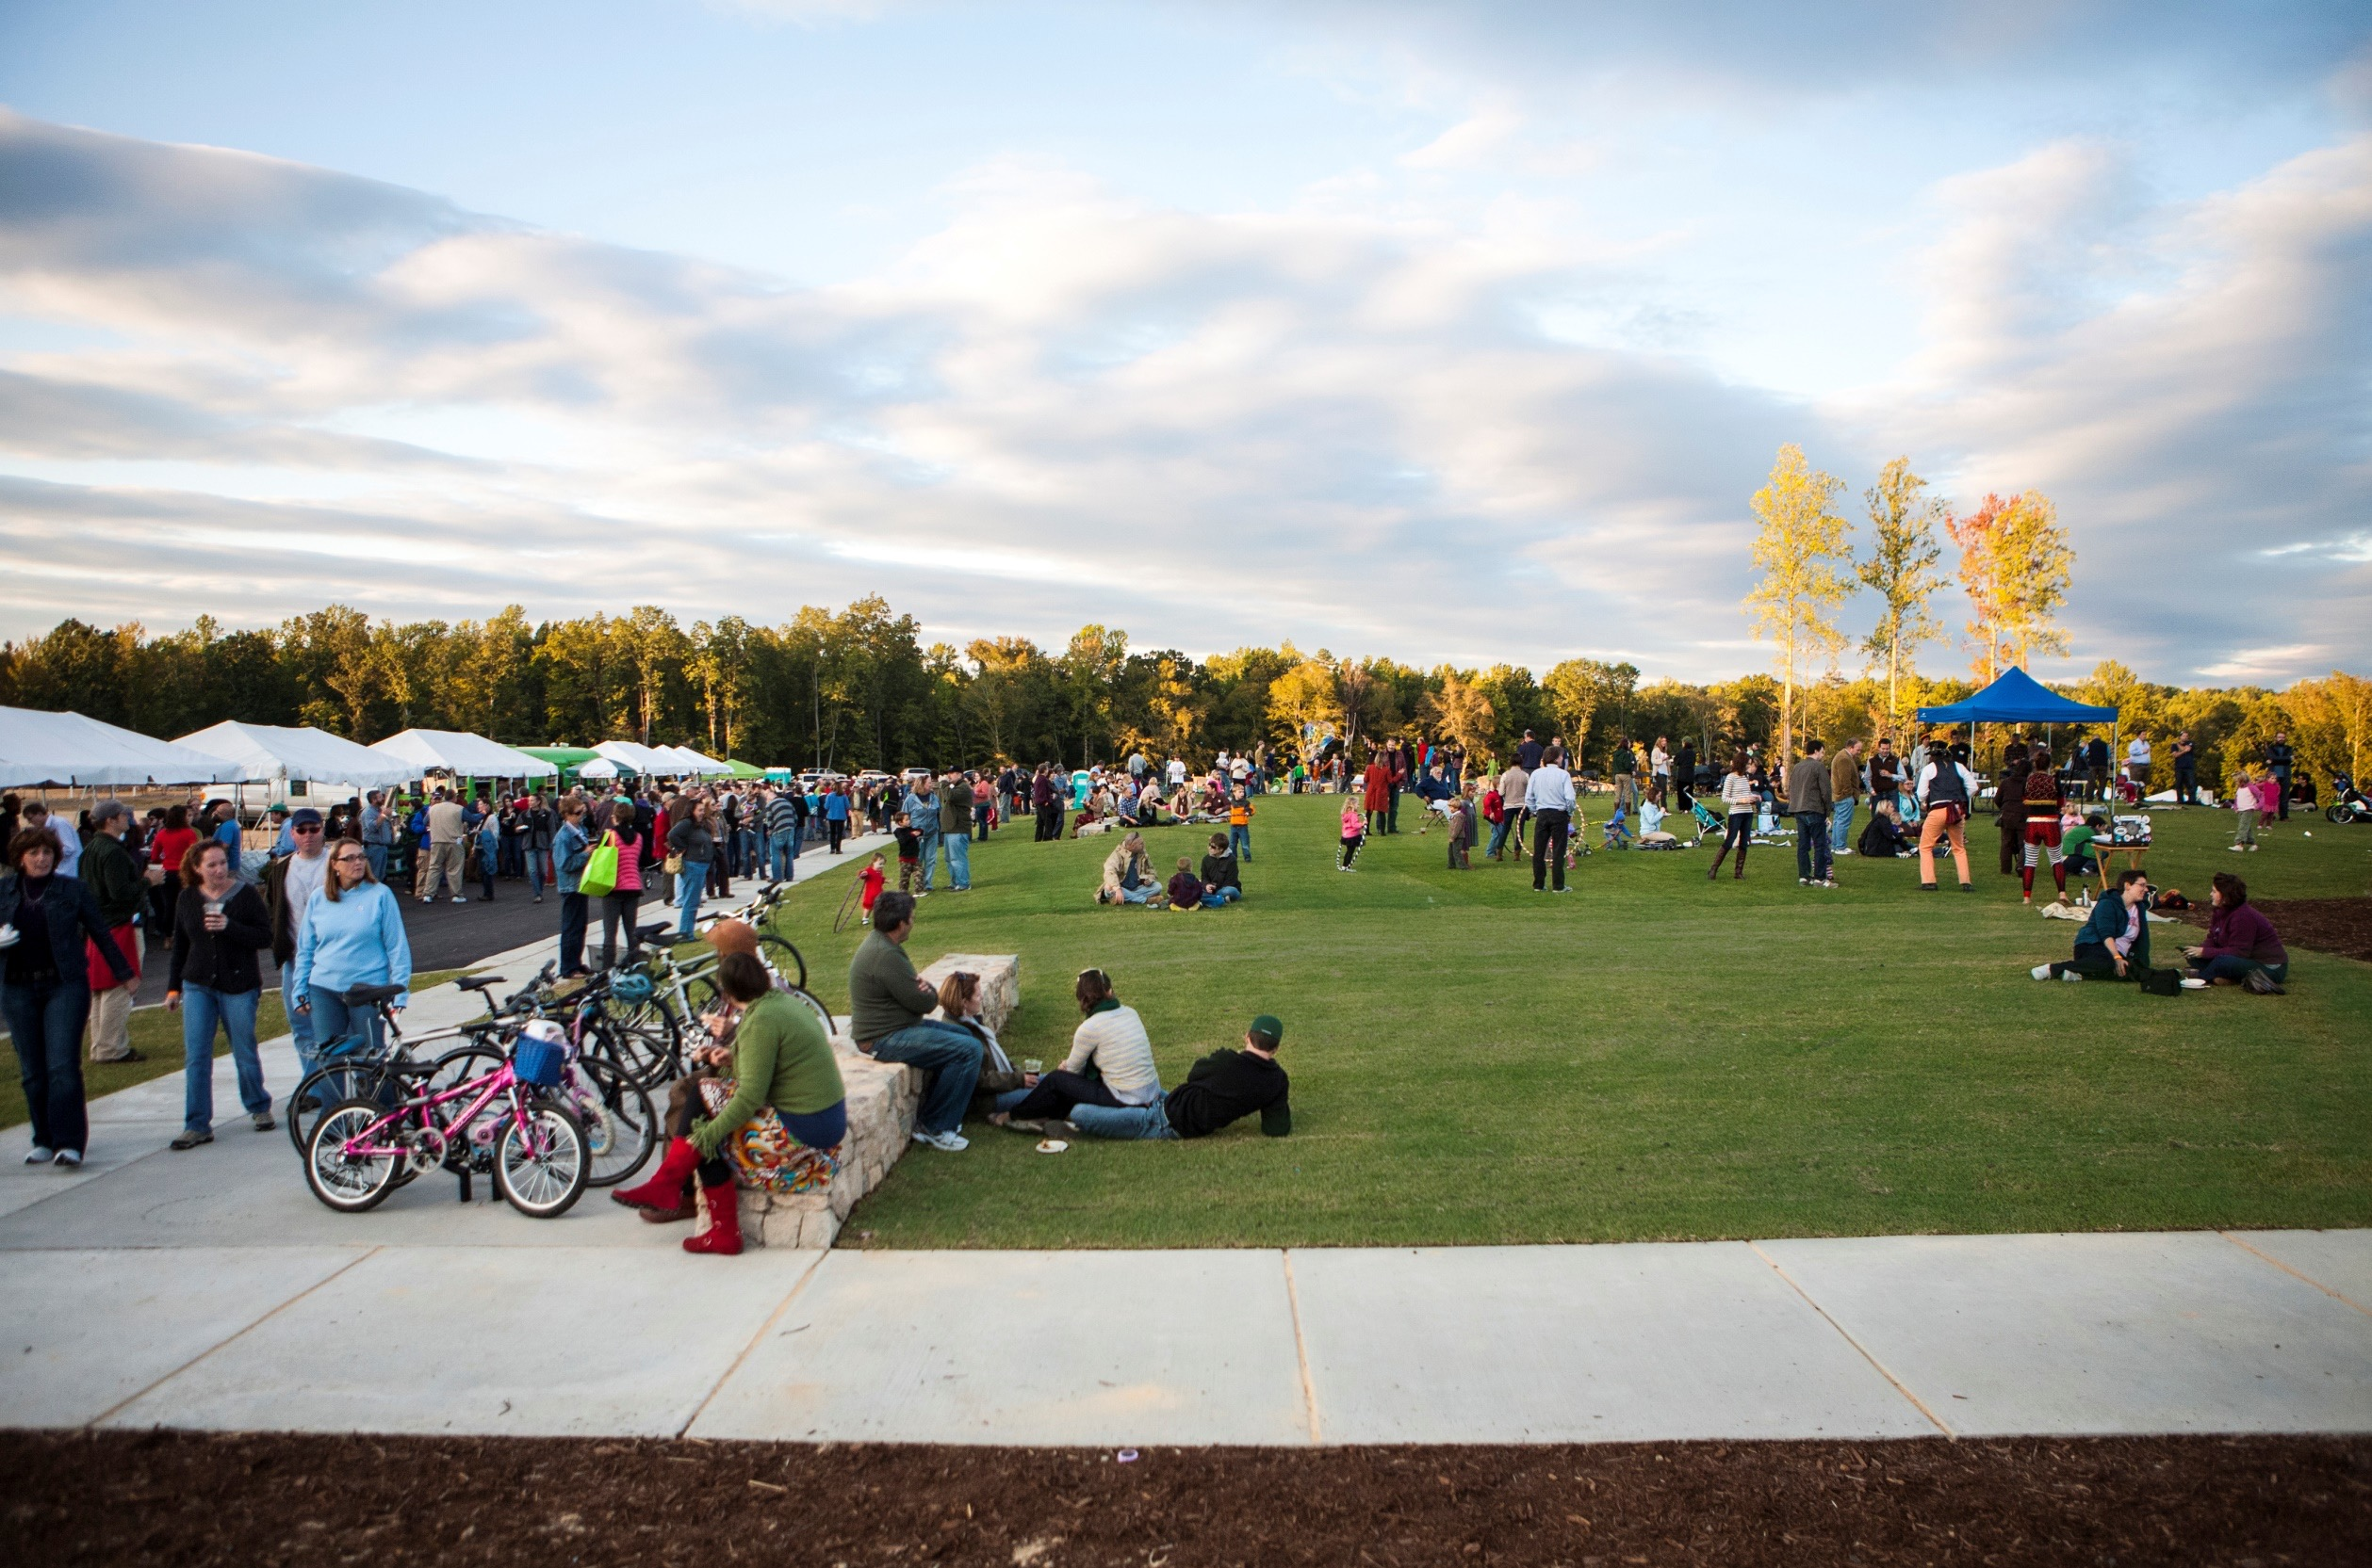
Transforming Lone Riders into Trail Tribes
Case Studies – Briar Chapel, Wendell Falls and Bexley
Notes:
Presentation Overview
Jody Leidolf – Newland Communities
Market Positioning (the buyer)
Development Program (integration into regional land use patterns)
Community Metrics (sustainability, partnerships, execution)
Colin Greene - Streetsense
Eric Davis – Surface 678

Slide 2
Jody Leidolf
M. Eric Davis, PLA, LEED AP®
Justin Lax
David Housekeeper

Slide 3
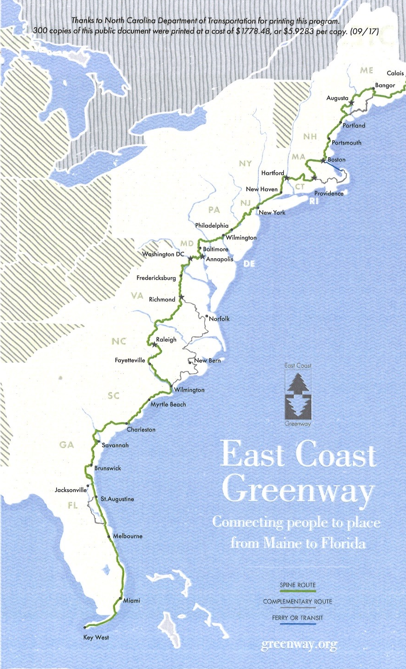
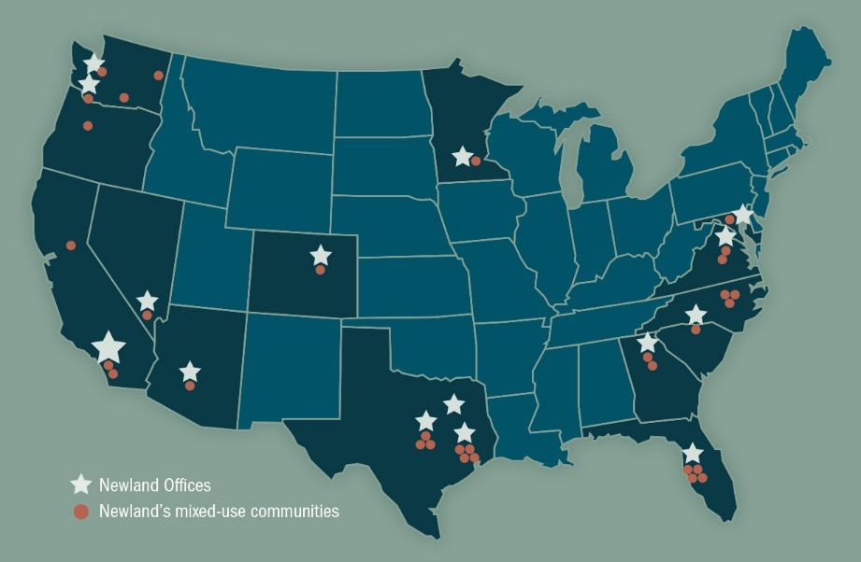
Recognition of Nodes along the East Coast Greenway (qty. 7)
Private/public trail extensions
More than 72 miles of trails added into greenway and trail systems
Embrey Mill, Stafford County
Briar Chapel, Chatham County
Wendell Falls, Wake County
RiverLights, Wilmington
Nexton, Berkeley County
Bexley, Pasco County
FishHawk Ranch, Hillsborough County

Slide 4
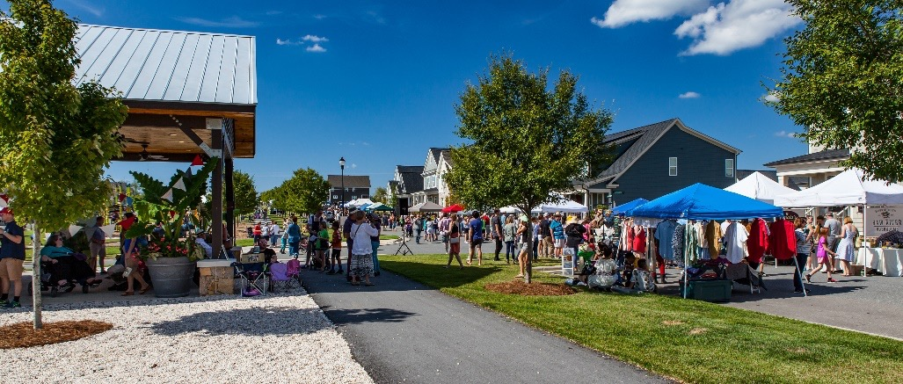
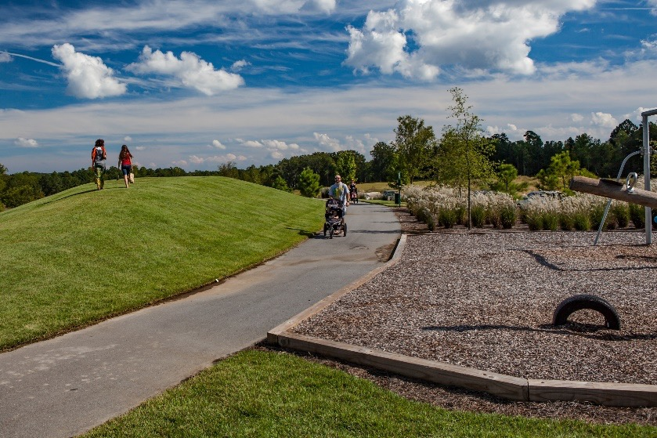
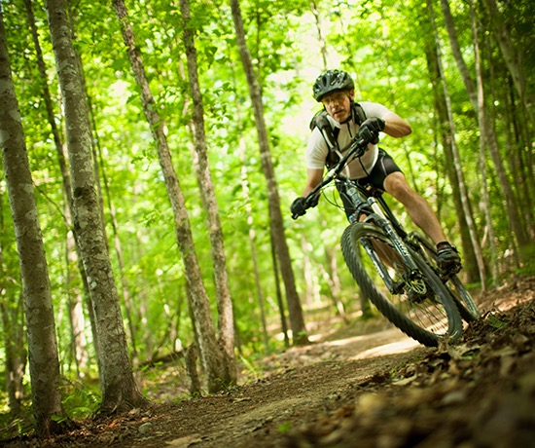
Why do we build trails?
Trails is are the #1 amenity residents request
Welcomes the local and regional community into our community
Eliminates/blurs property lines
Builds community partnerships
Social capital
Promotes healthy lifestyle

Slide 5
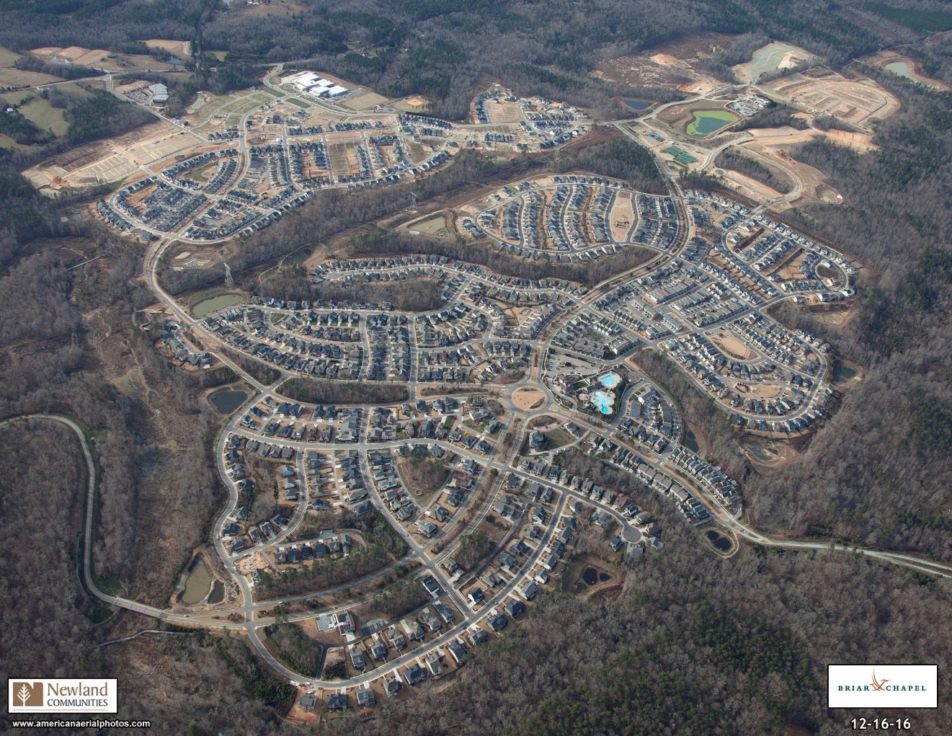
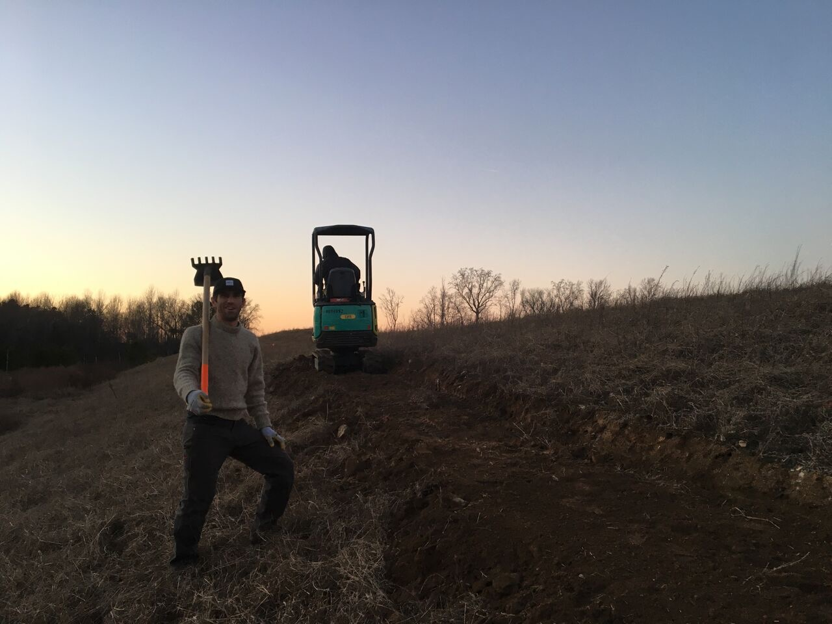
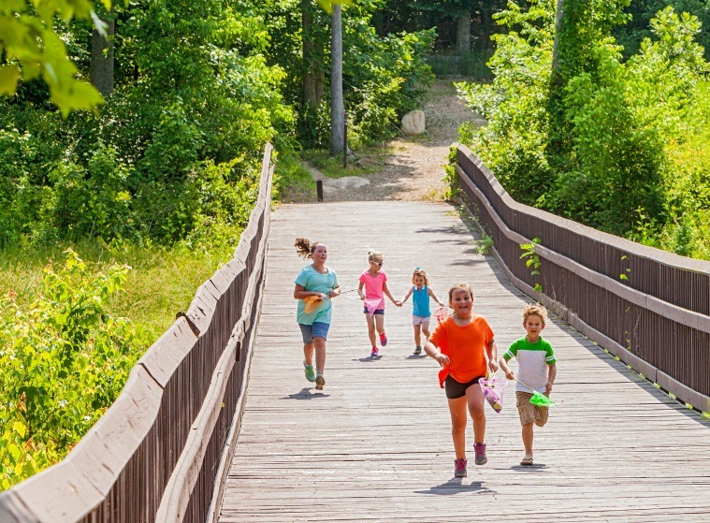
Ten years of building trails
14 miles of trails completed, 24 total miles planned
Open to the public
Combination of hard surface, mulch, and dirt
TORC was critical in design, construction and operation of the trail system

Slide 6
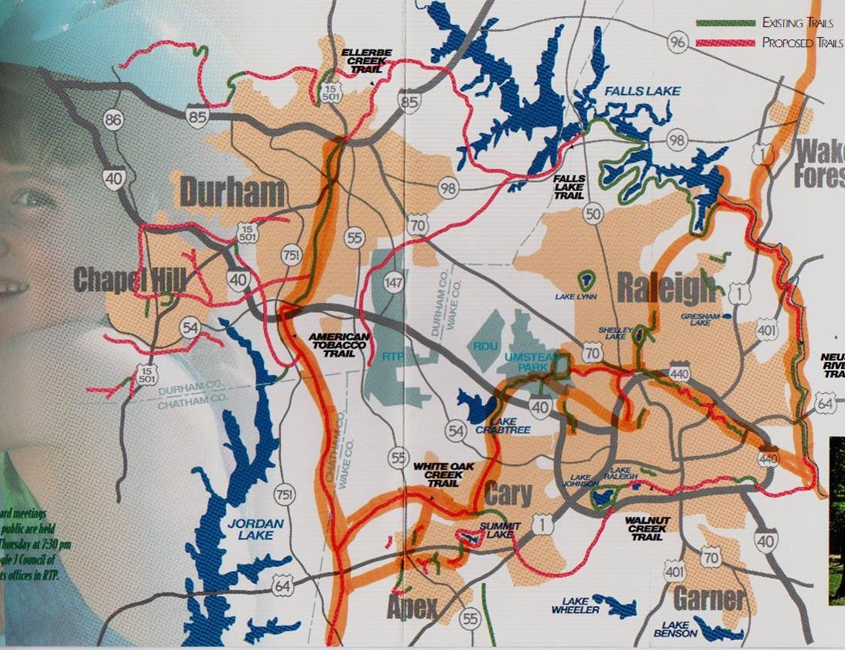
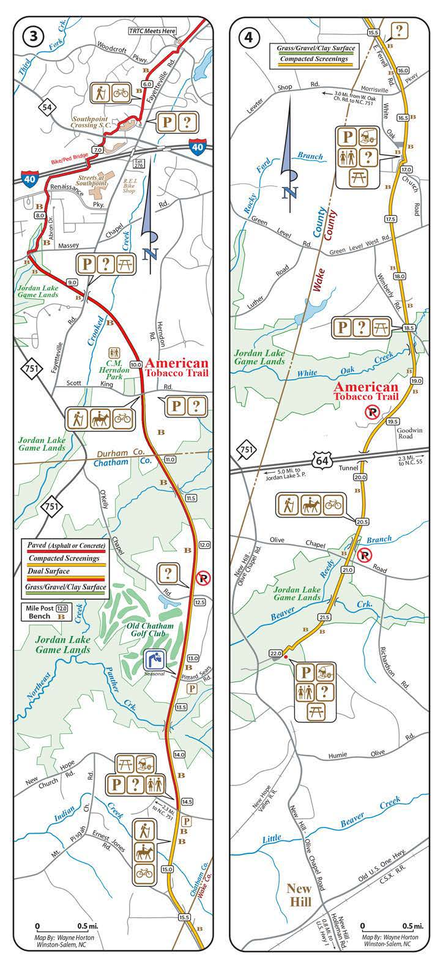
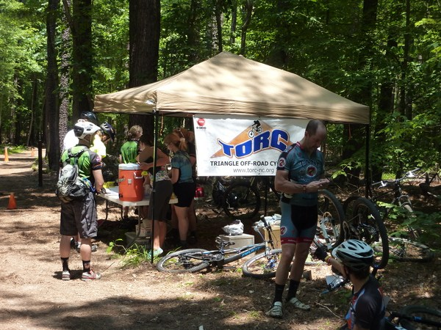
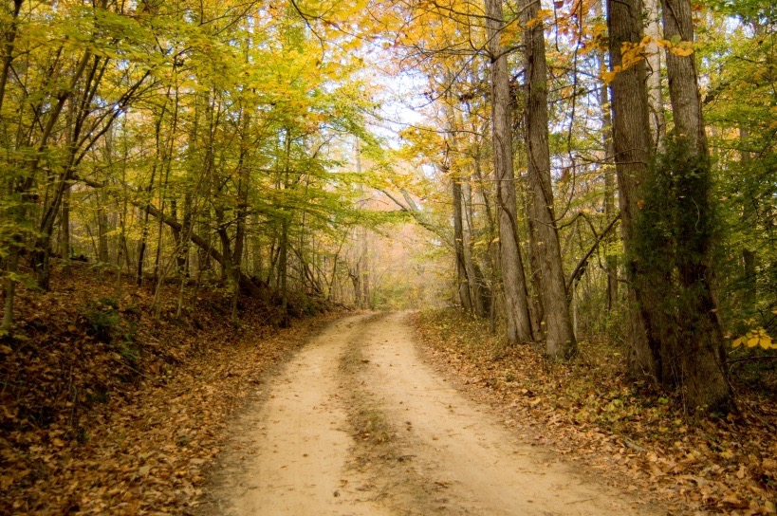
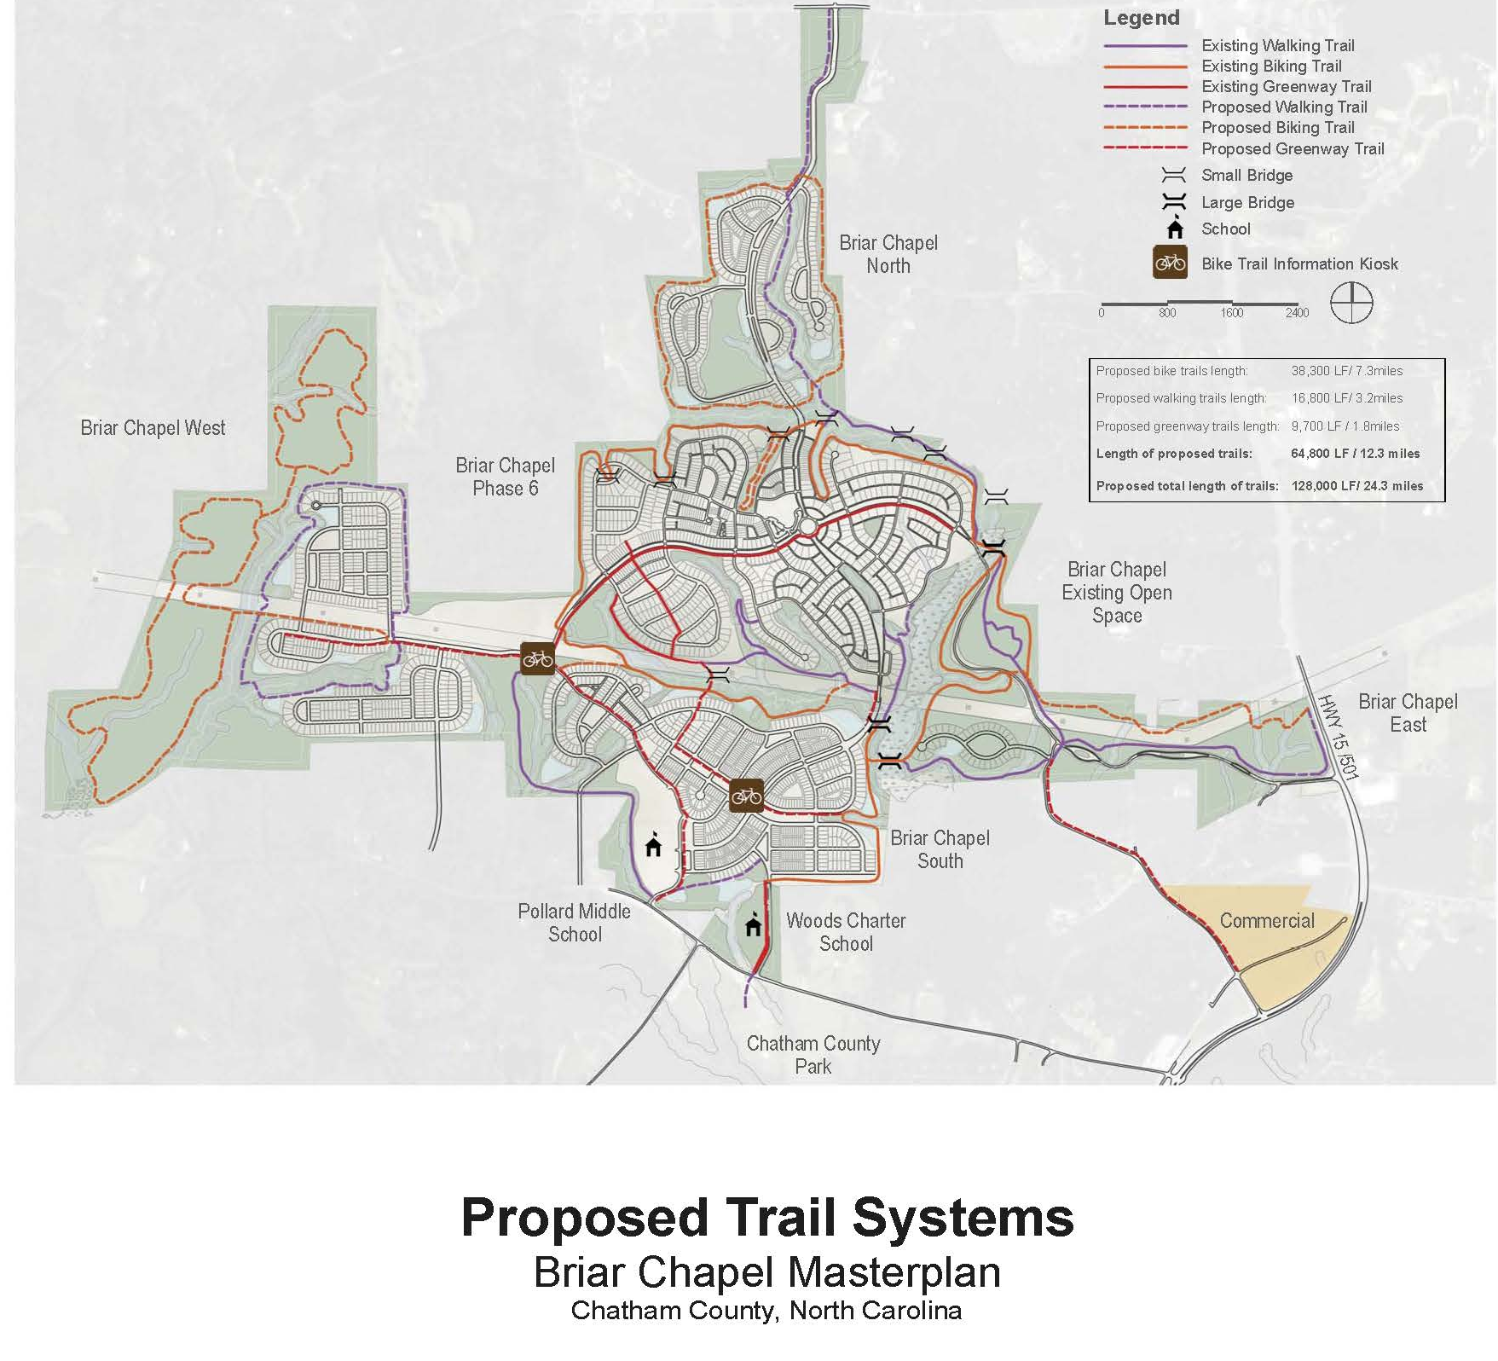

Slide 7
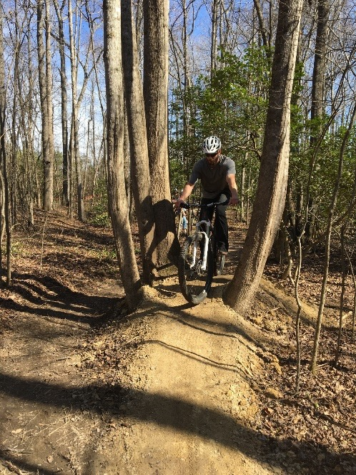
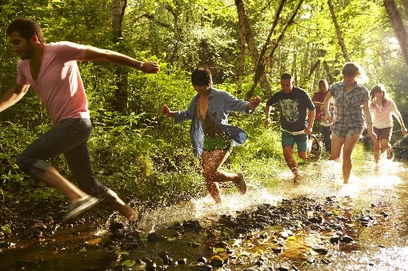
Two years of active trail building
3.5 miles of trails completed, 12 total miles planned – links to Mingo and Neuse trails systems
Open to the public
Combination of hard surface, mulch, and dirt
Avid and TORC construct, market and provide operational support

Slide 8
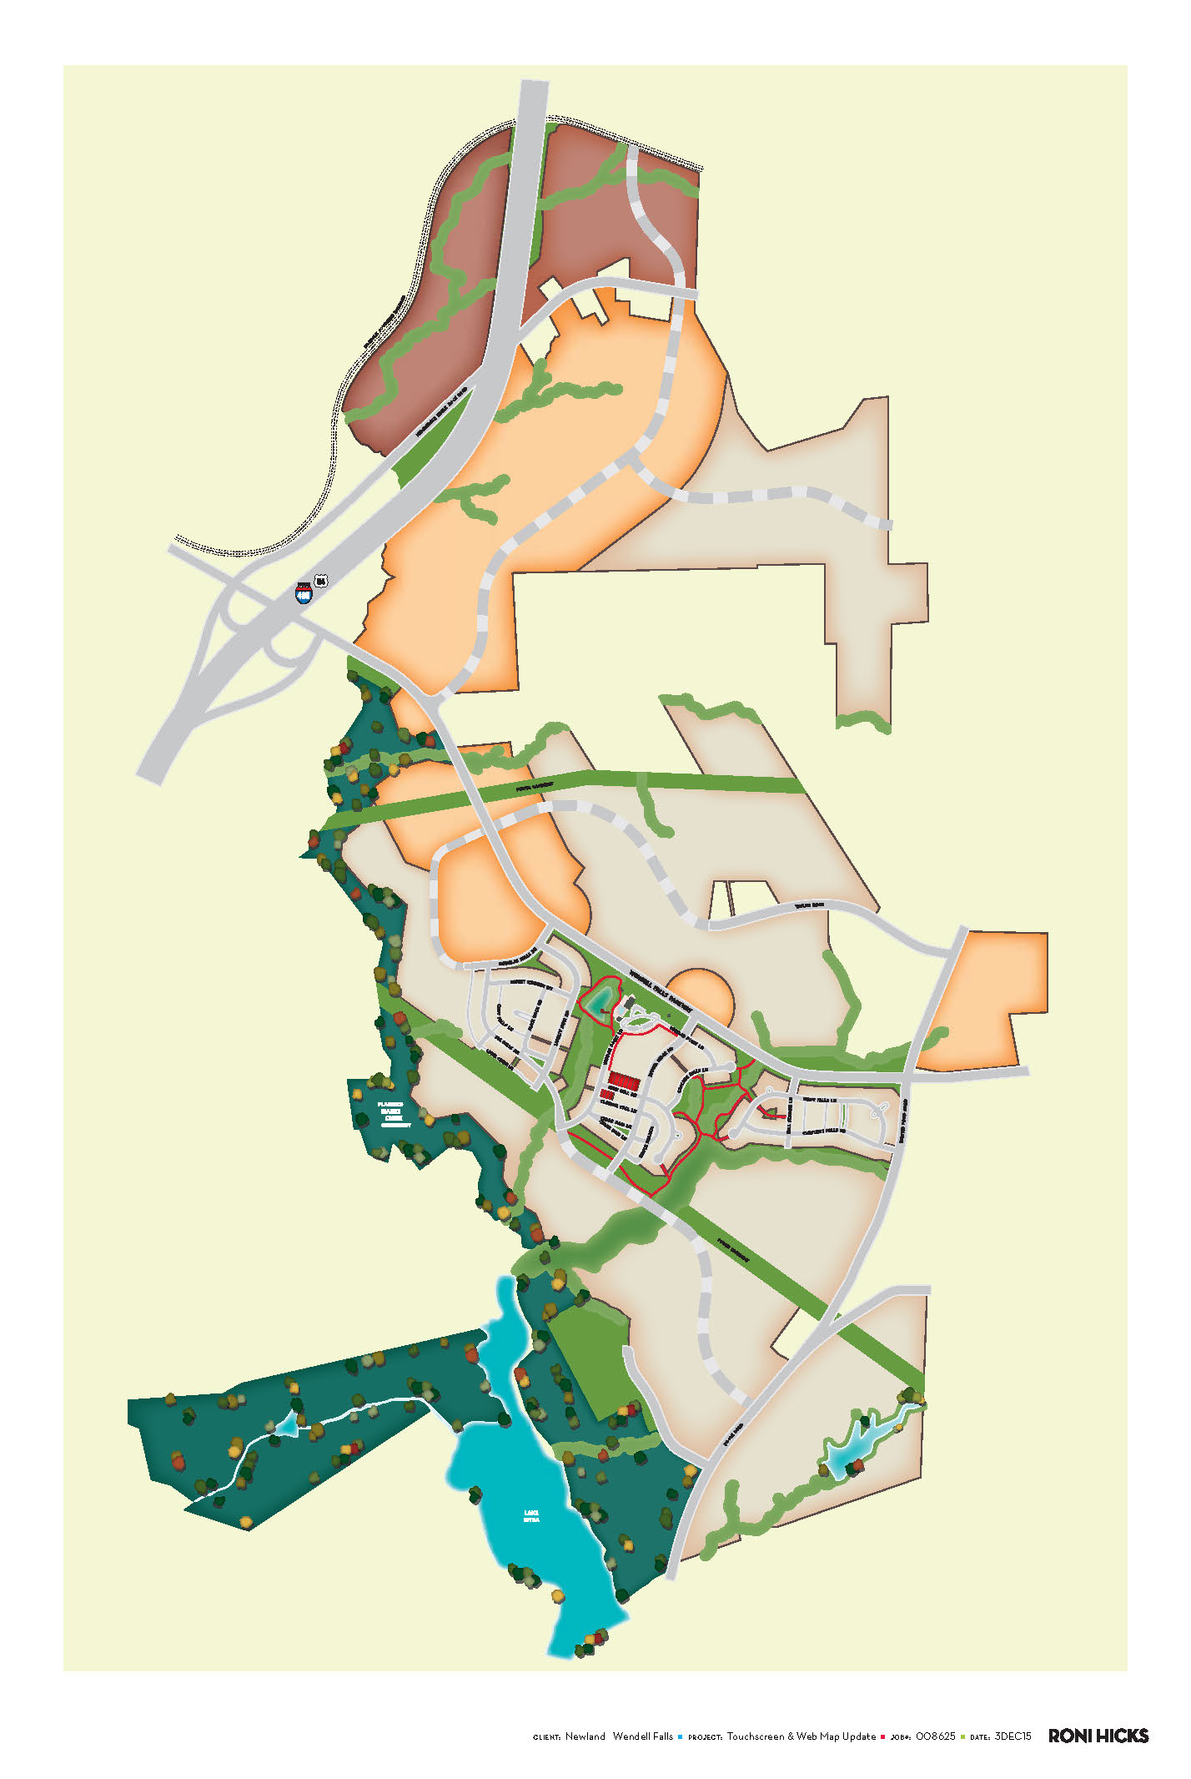
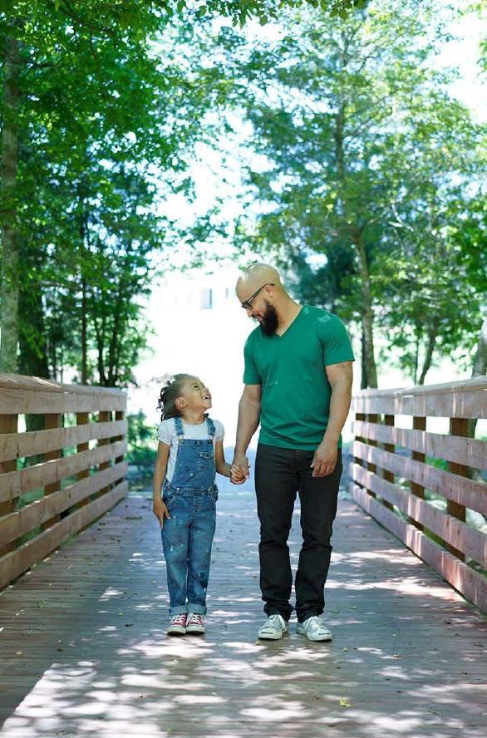
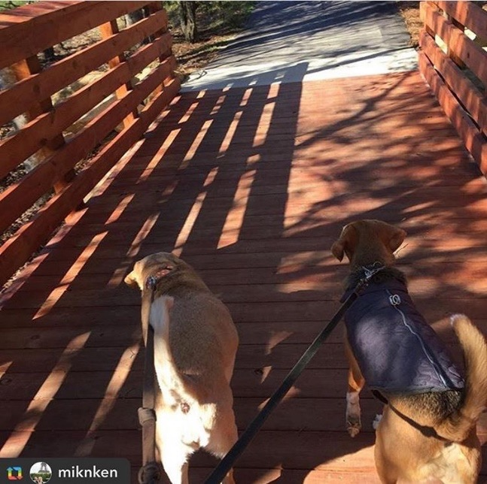

Slide 9
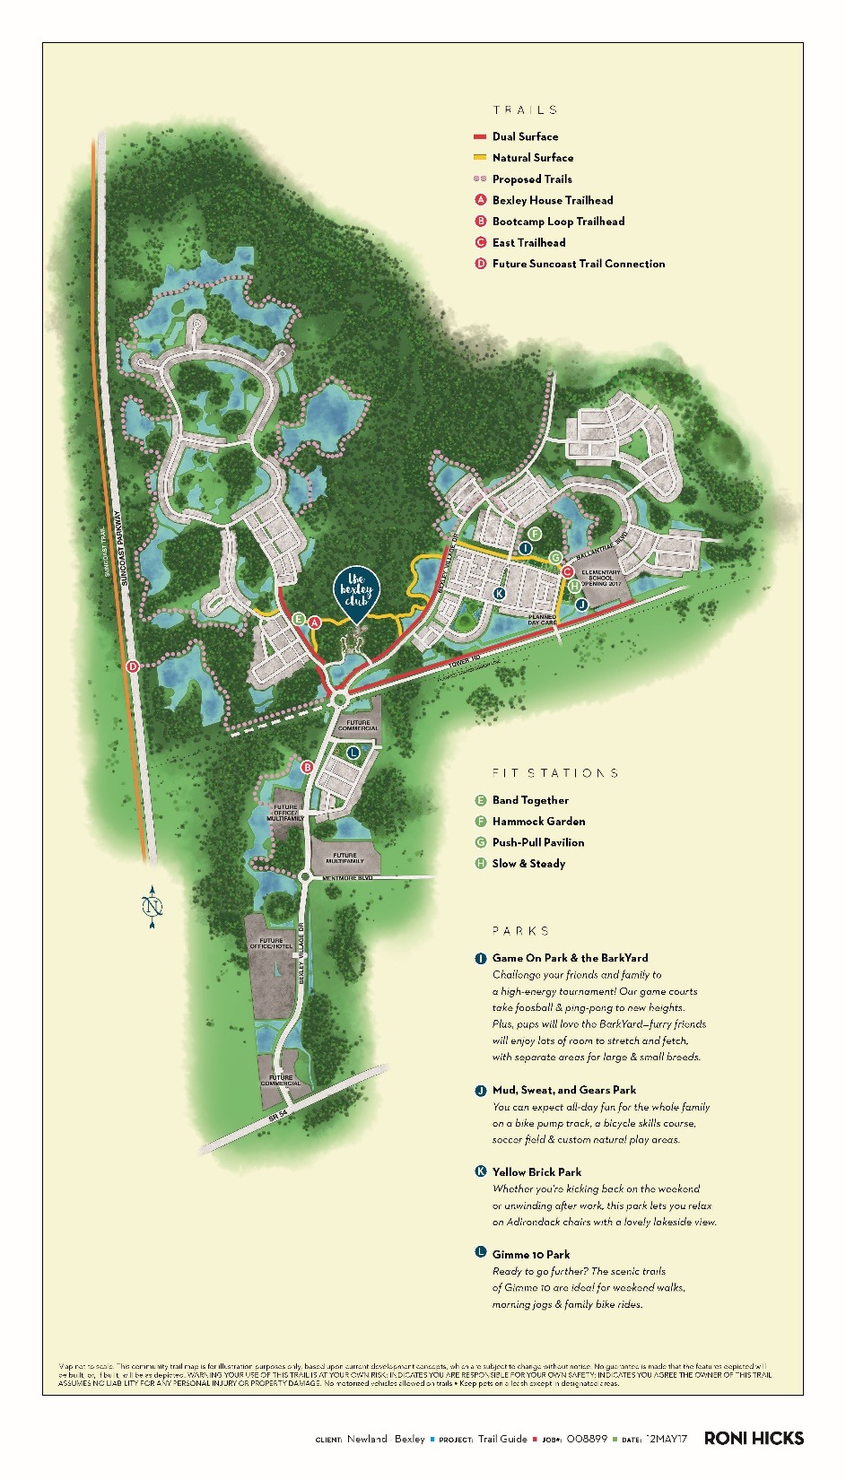
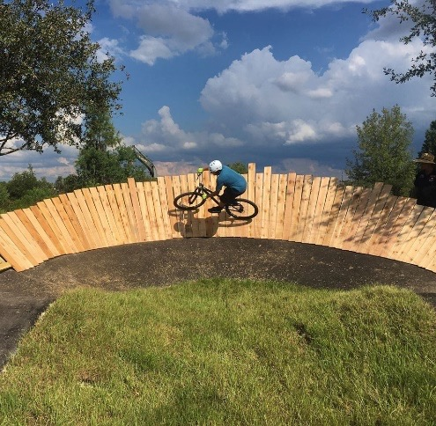
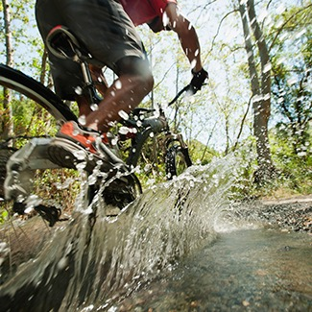
One year of constructing trails
3.5 miles of trails completed, 10 total miles planned
Avid Trails constructed pump track and multi-surface trail
Combination of hard surface, mulch, and dirt
Key marketing differentiator

Slide 10
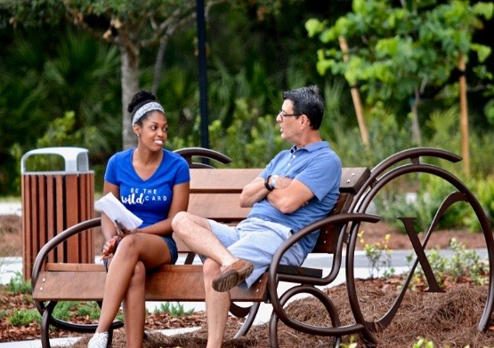
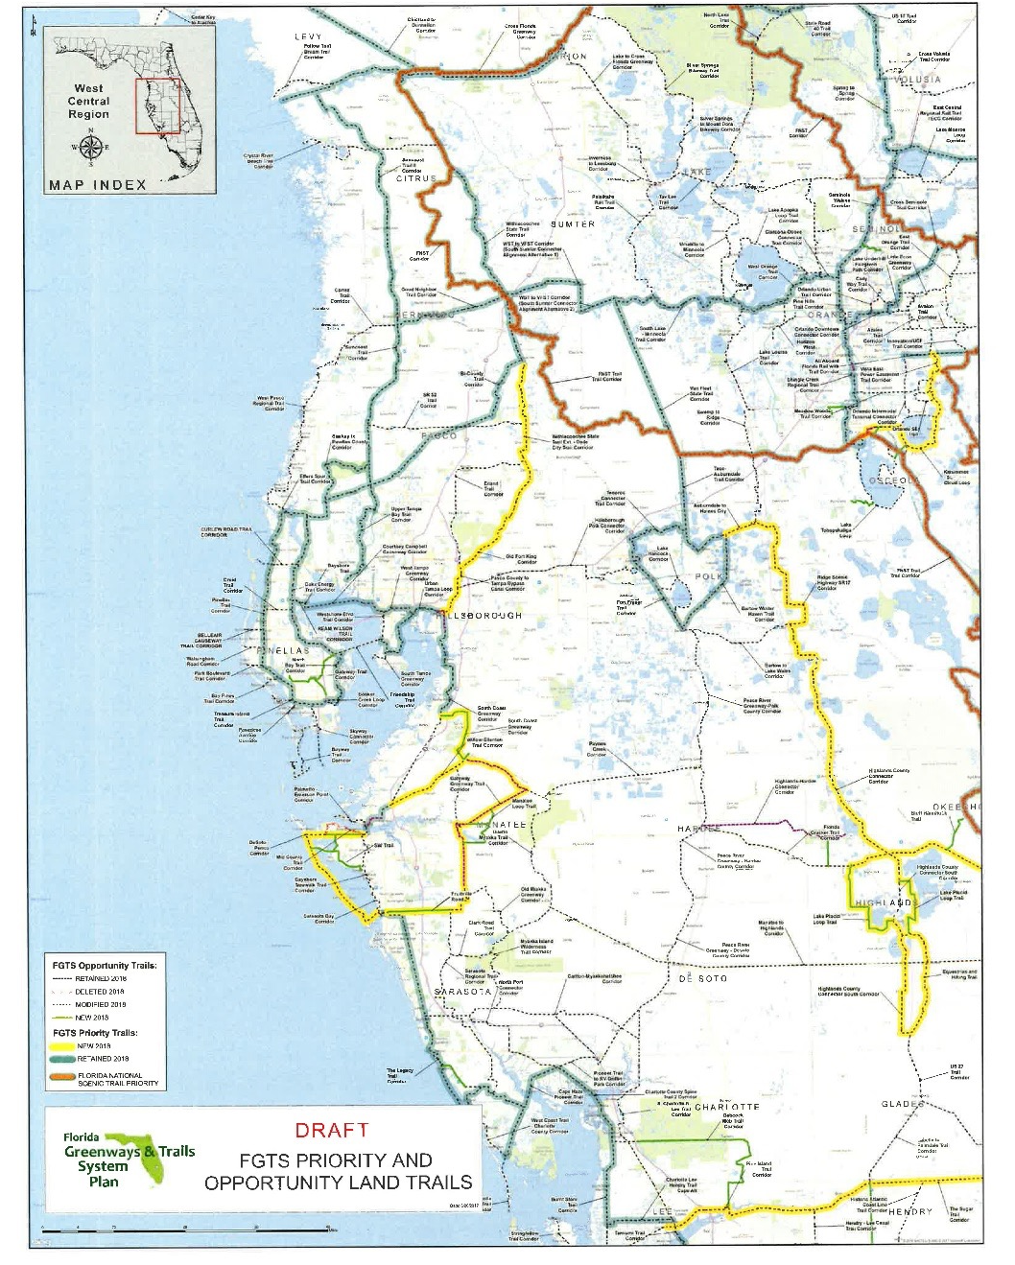
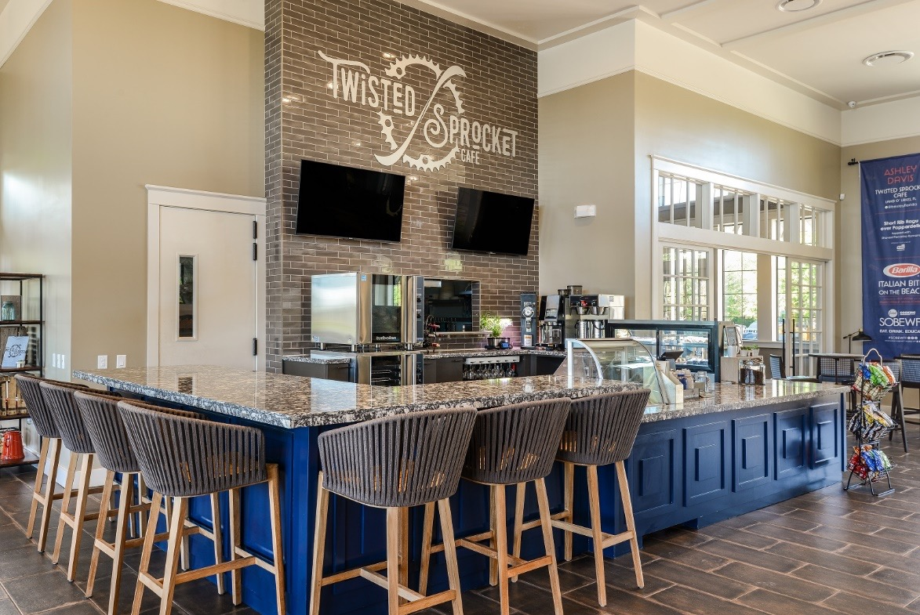

Slide 11
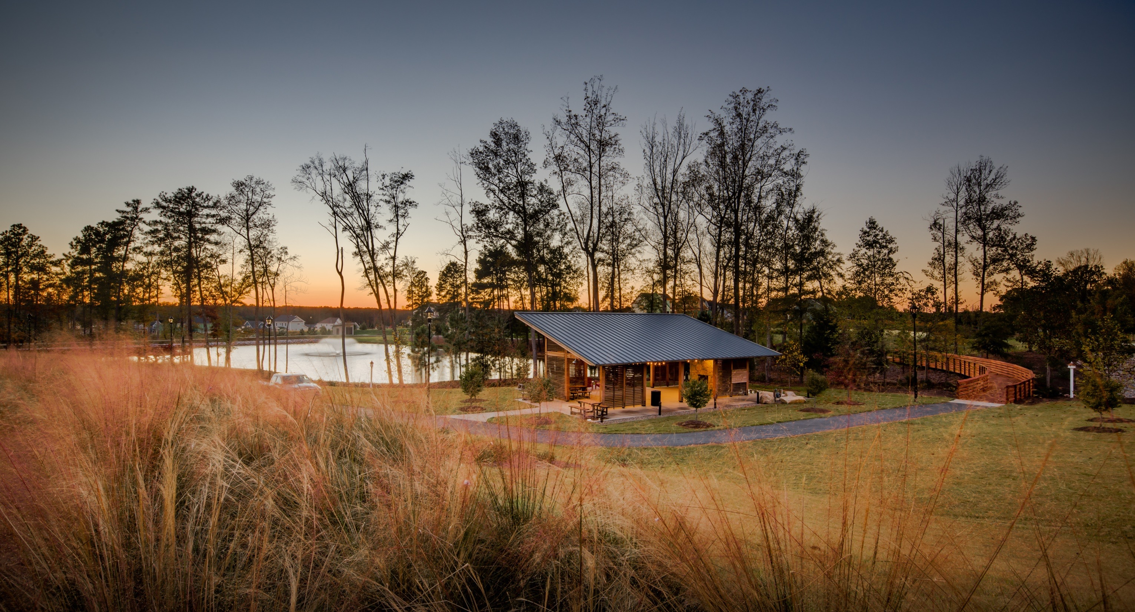

Slide 14
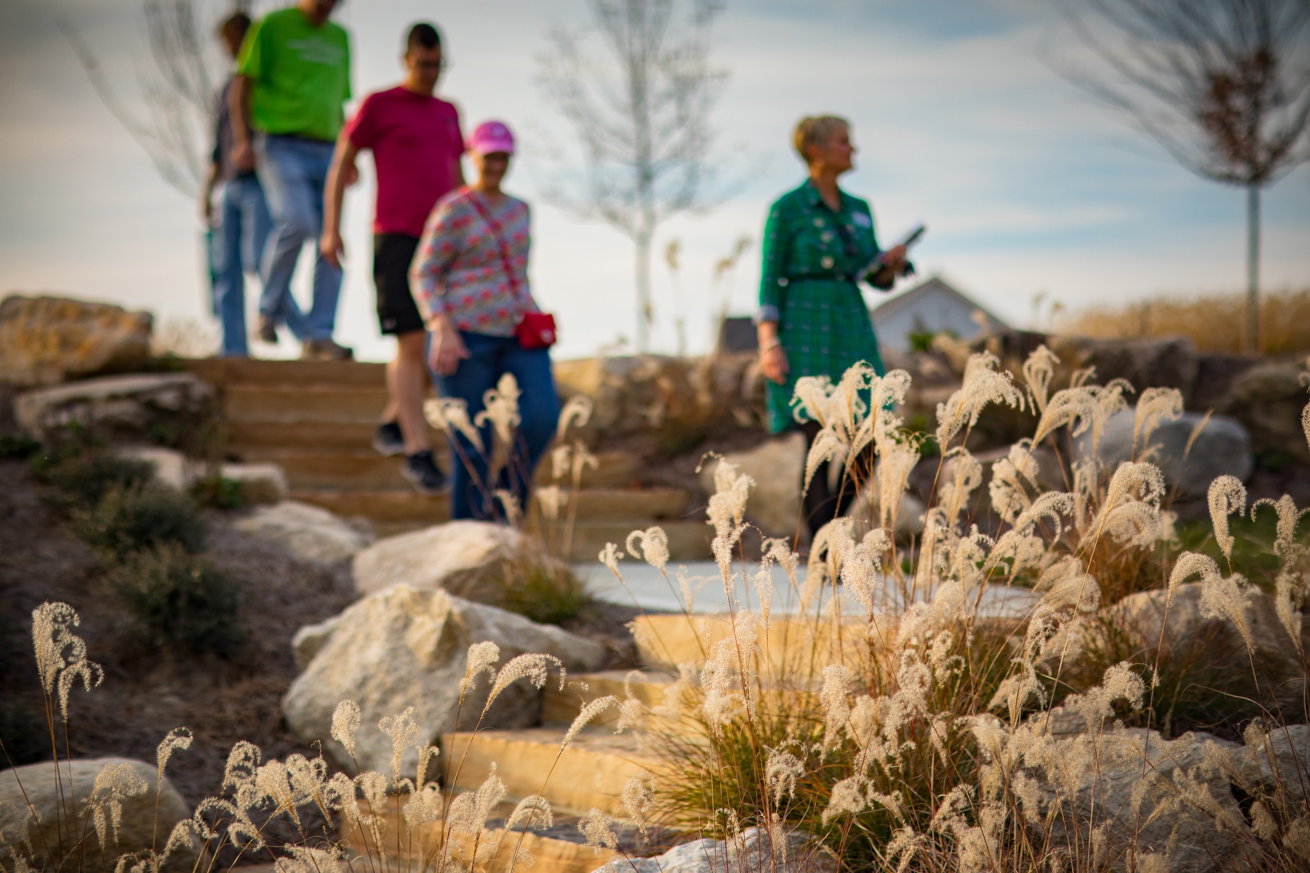

Slide 15
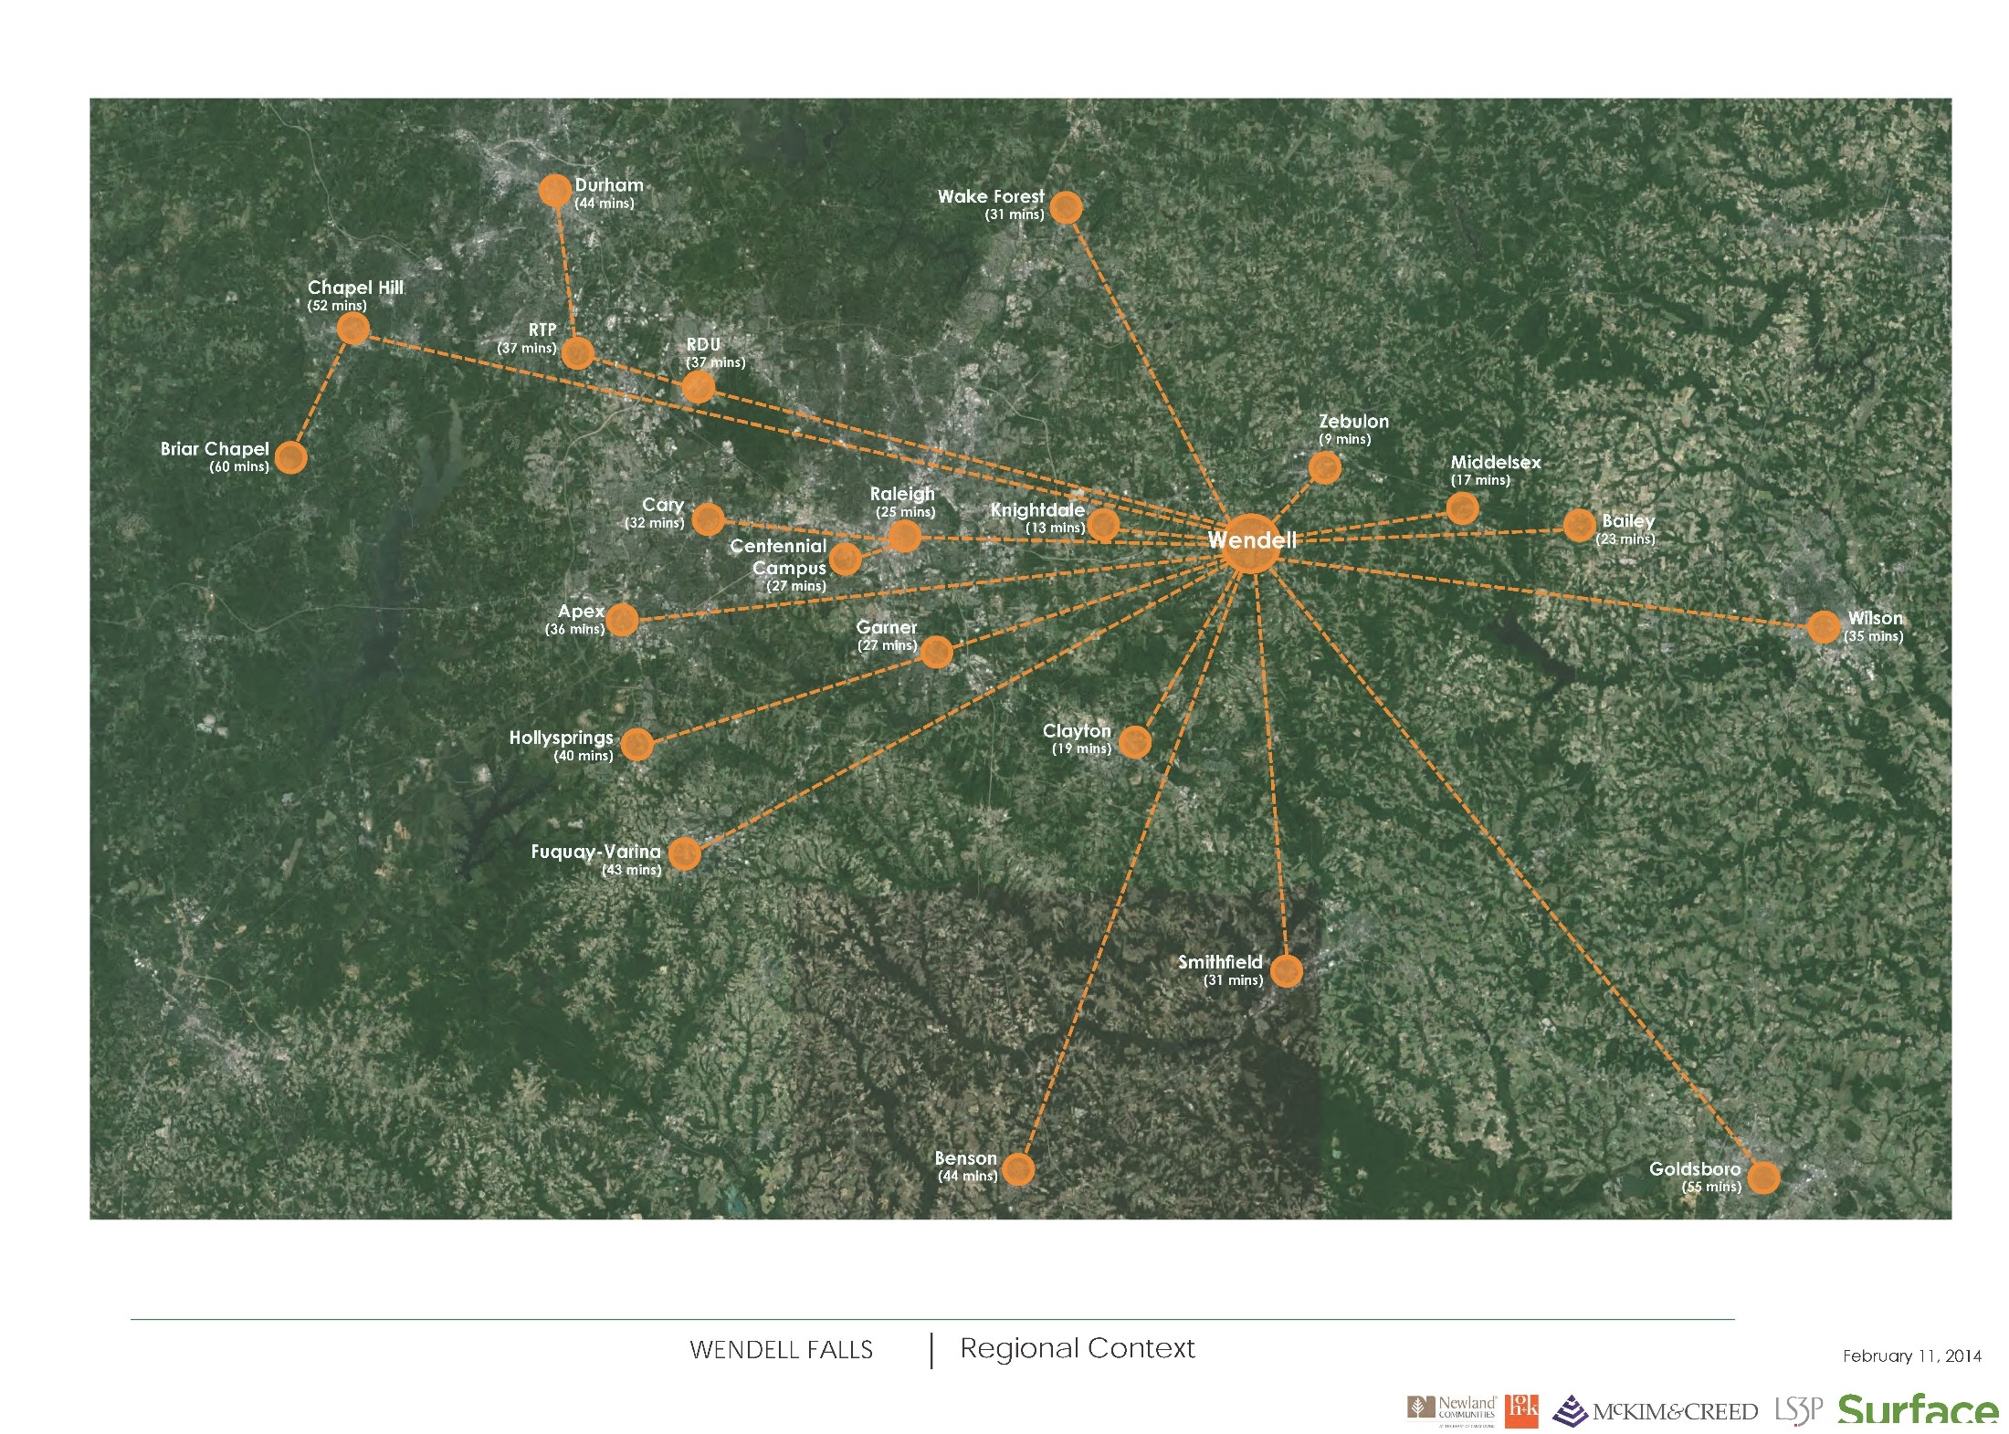

Slide 16
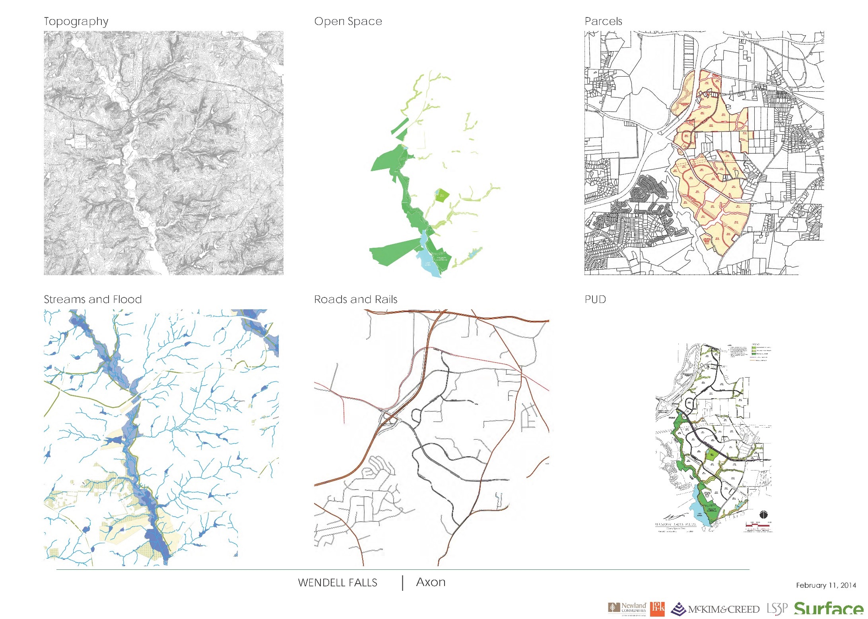

Slide 17
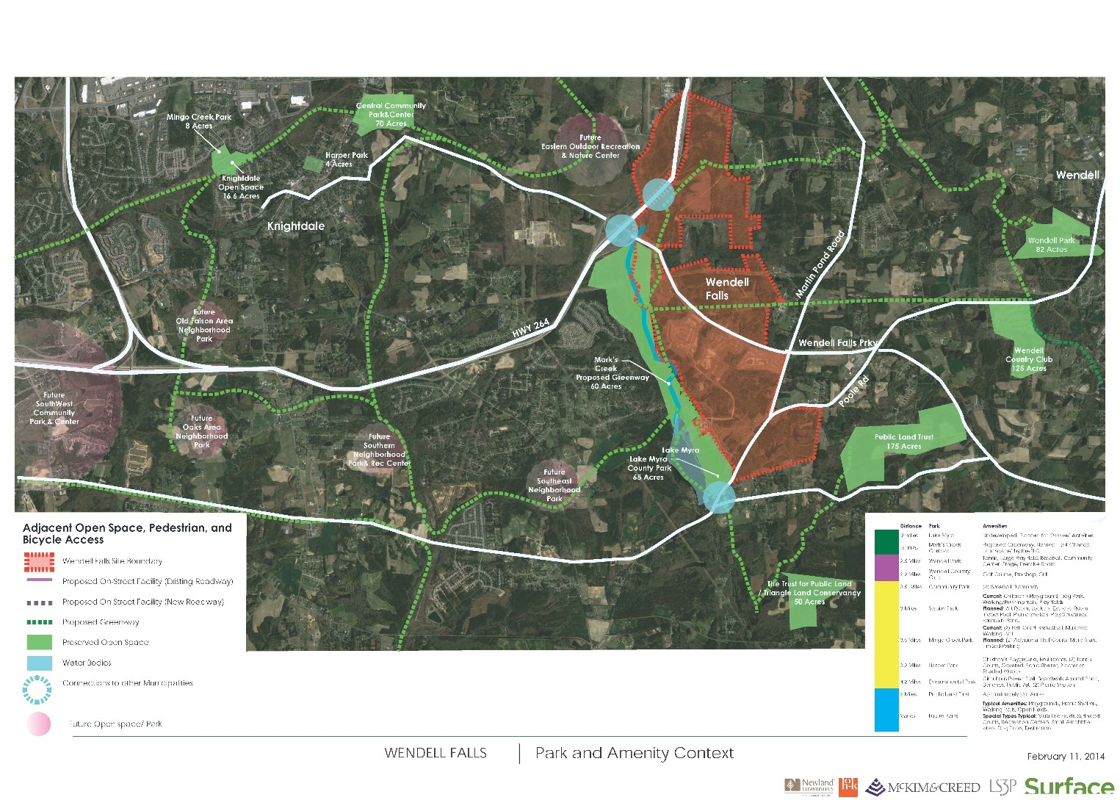

Slide 18
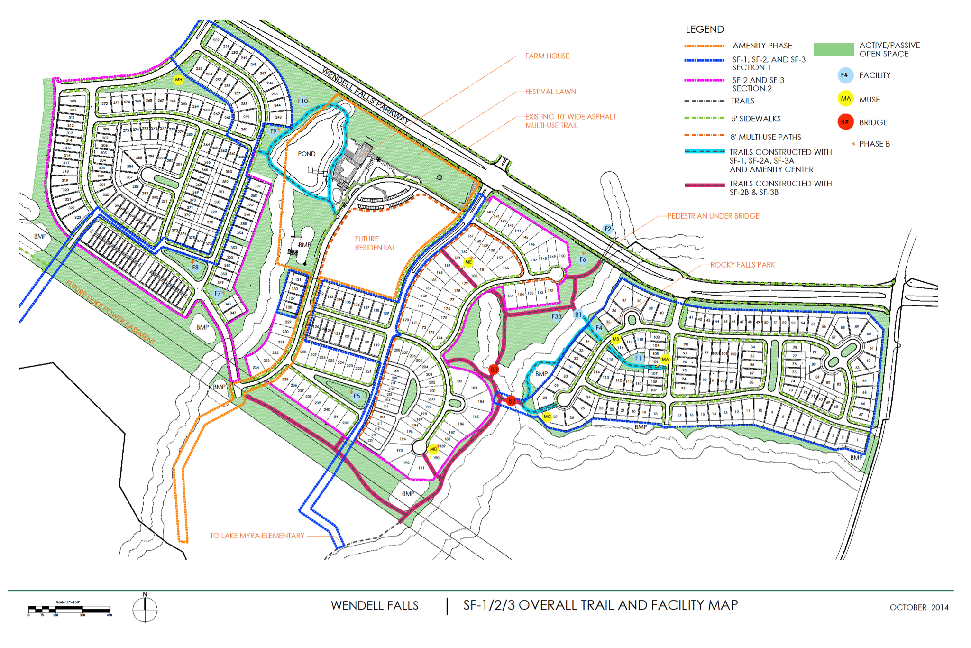

Slide 19
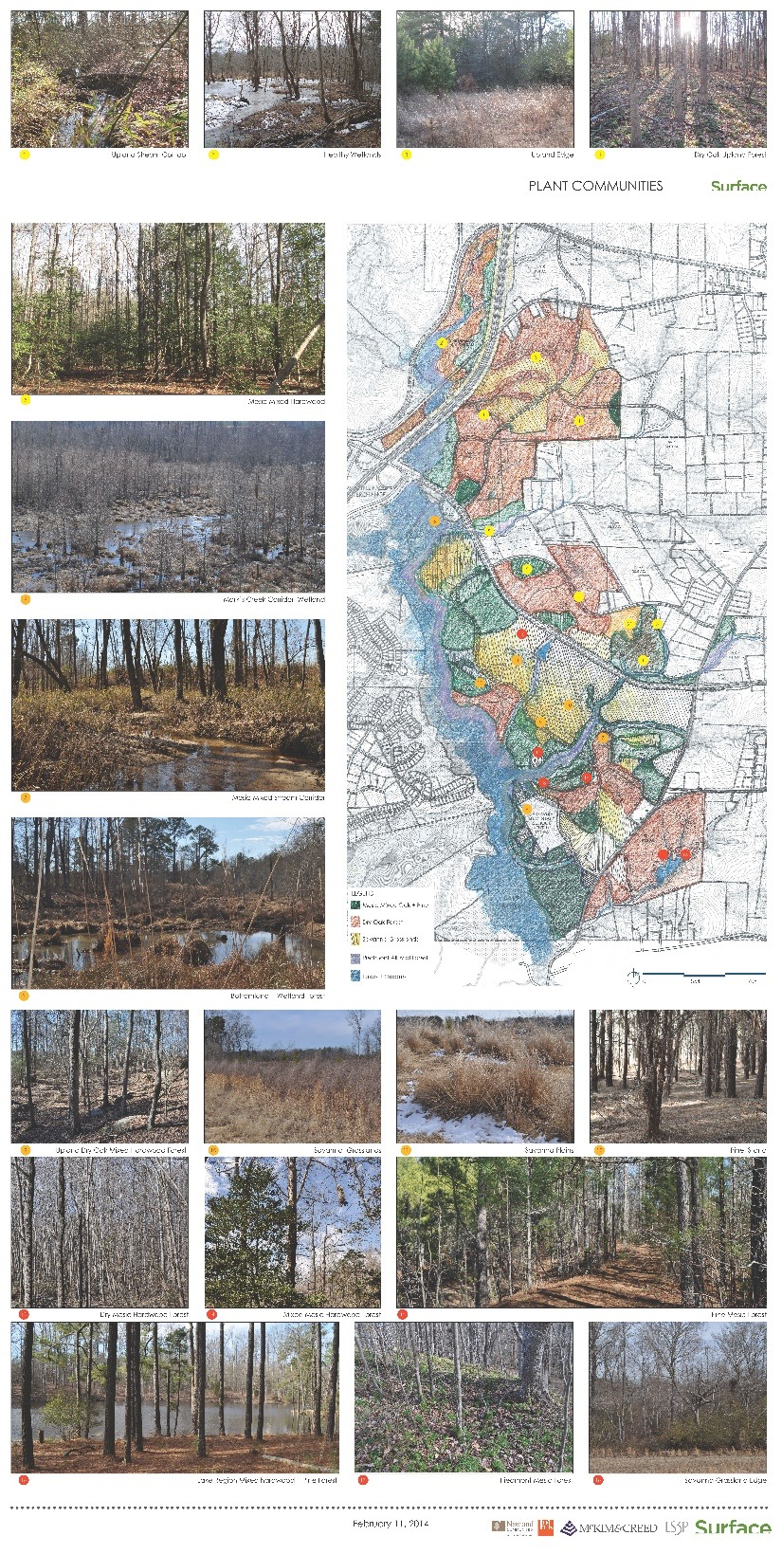
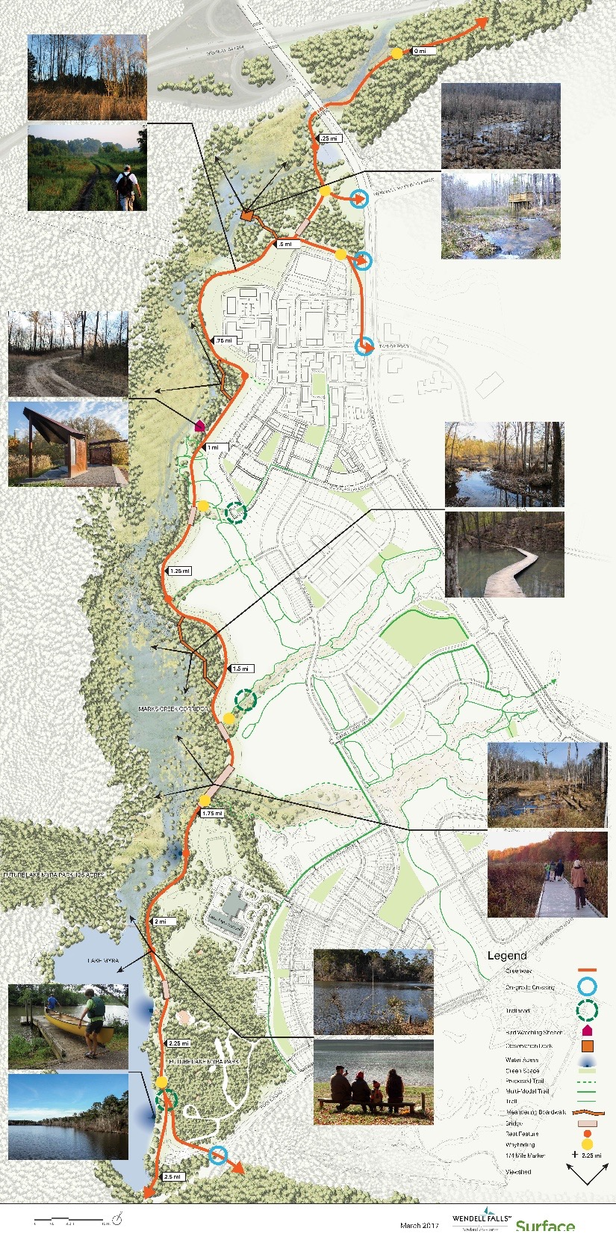

Slide 20
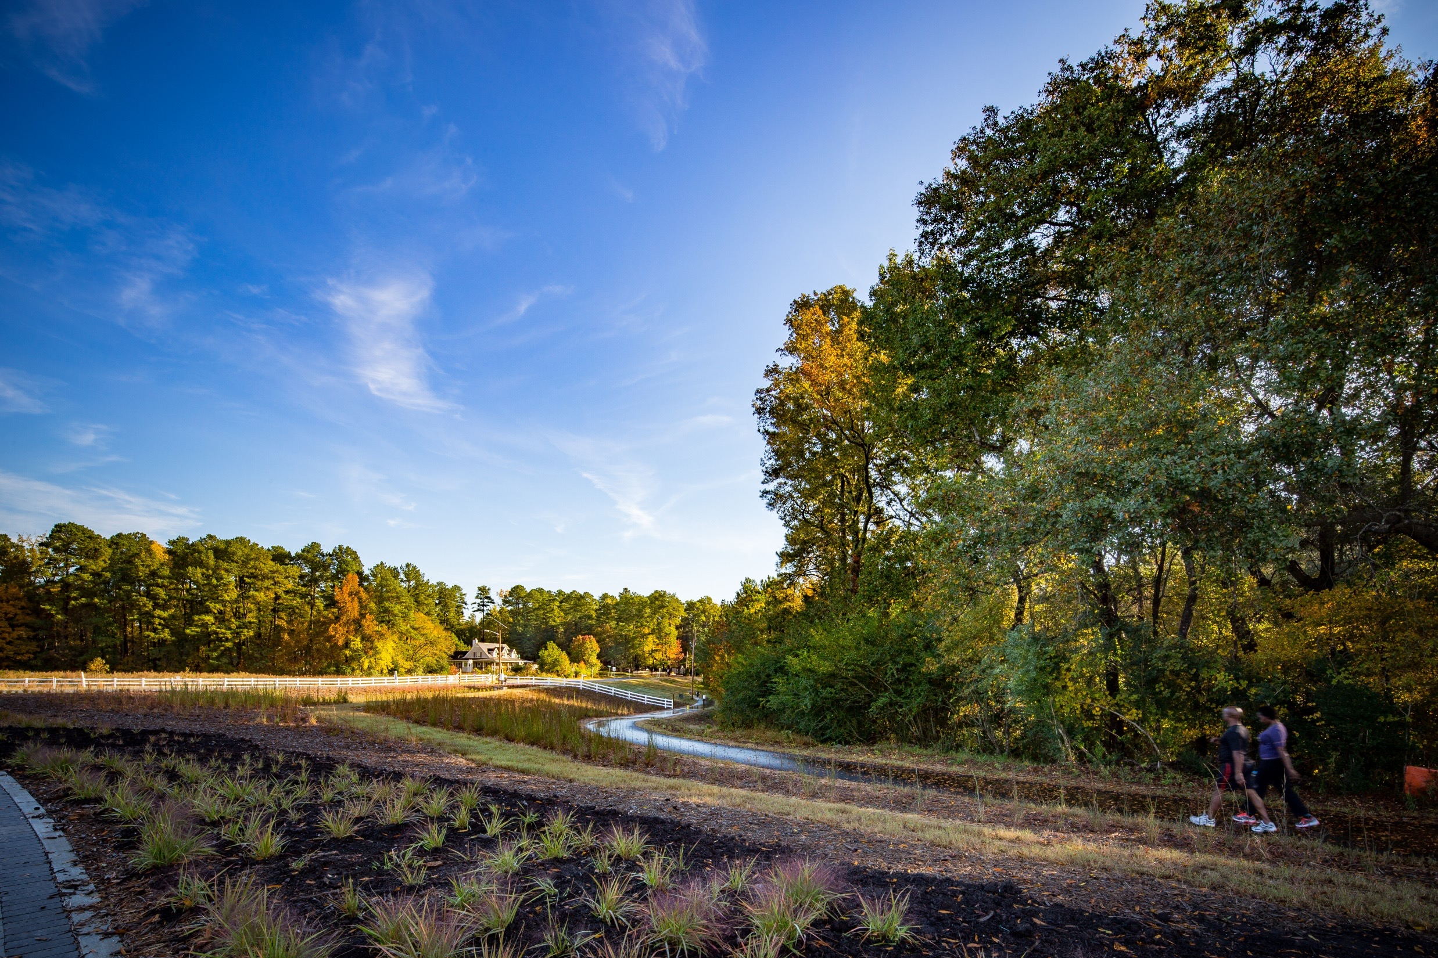

Slide 32
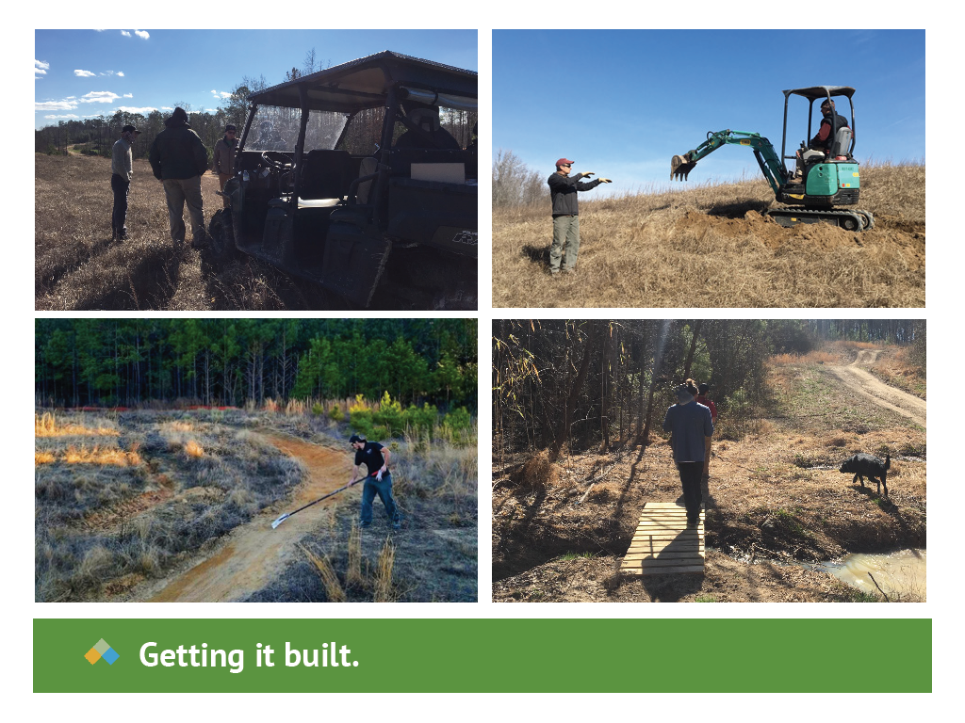

Slide 36
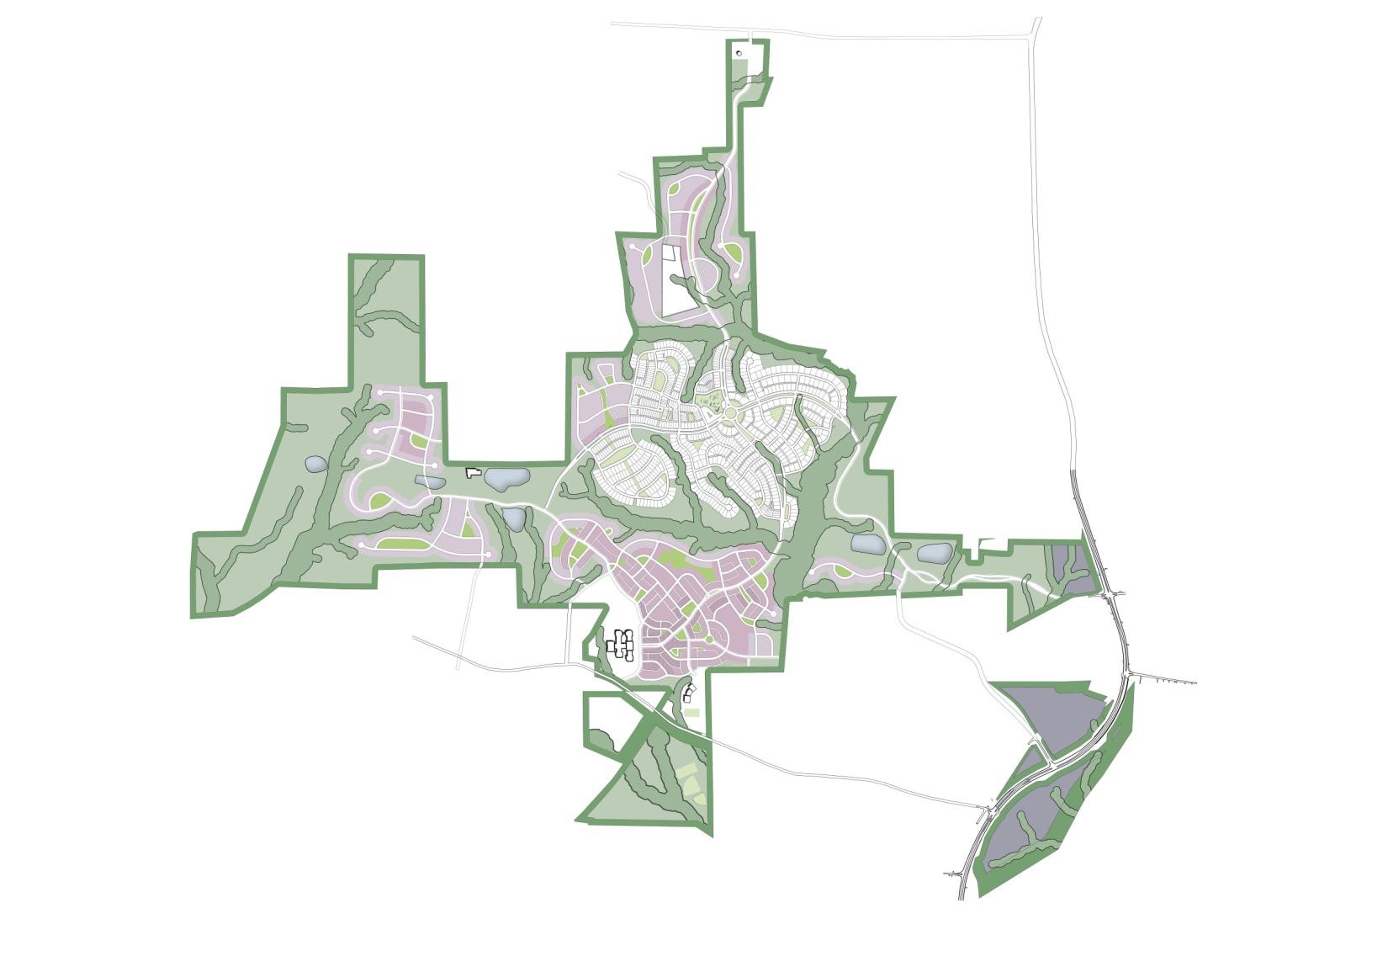
TORC’s role within Briar Chapel and Wendell Falls
Triangle Off-Road Cyclist (TORC) is a non-profit, volunteer organization (501) (C) (3) dedicated to safeguarding the future of mountain biking in the Triangle area of North Carolina.
Over 500 members and growing
Began building trails in Briar Chapel in 2007
Continue expansion of trails within Briar Chapel
Sponsor races
Promotes trail access
Notes:
The Special District Zone

Slide 37
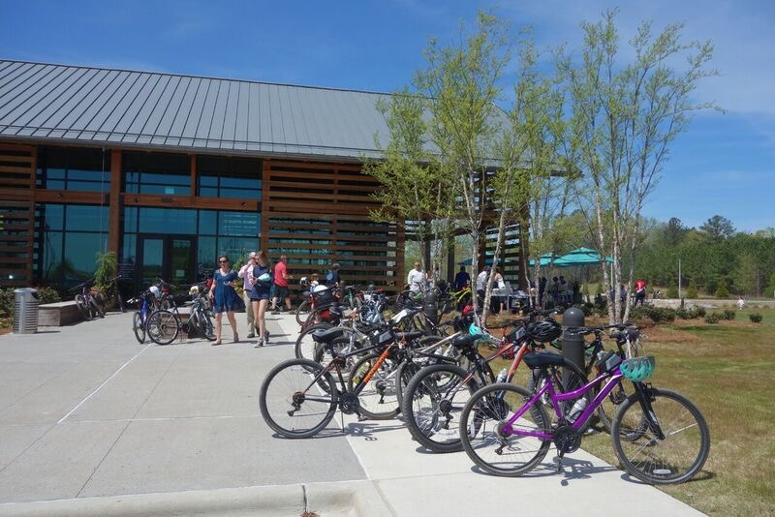
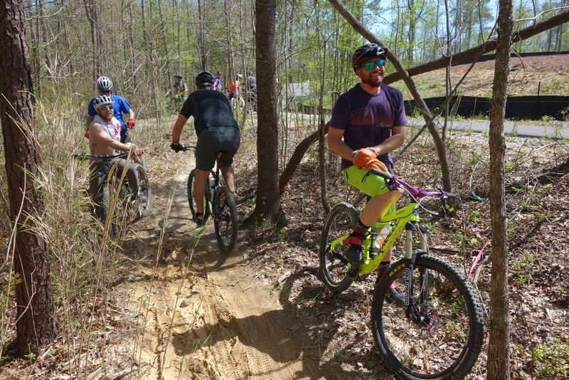
Events
Promote the sport of mountain biking through a warm welcome to all that enthusiastic and interested in the sport
We offer rides, clinics, and events to accommodate people with all skill levels
TORC holds several races a year with multiple categories so you can compete at your skill level as a individual or a team
Continue expansion of trails within Briar Chapel

Slide 38
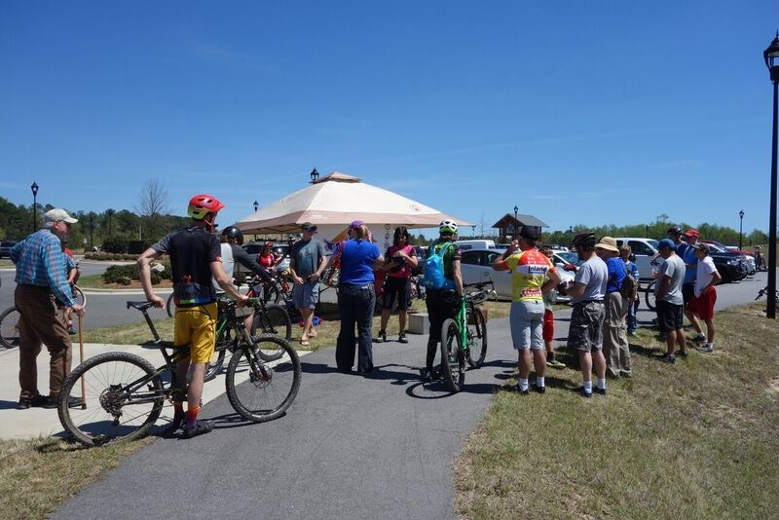
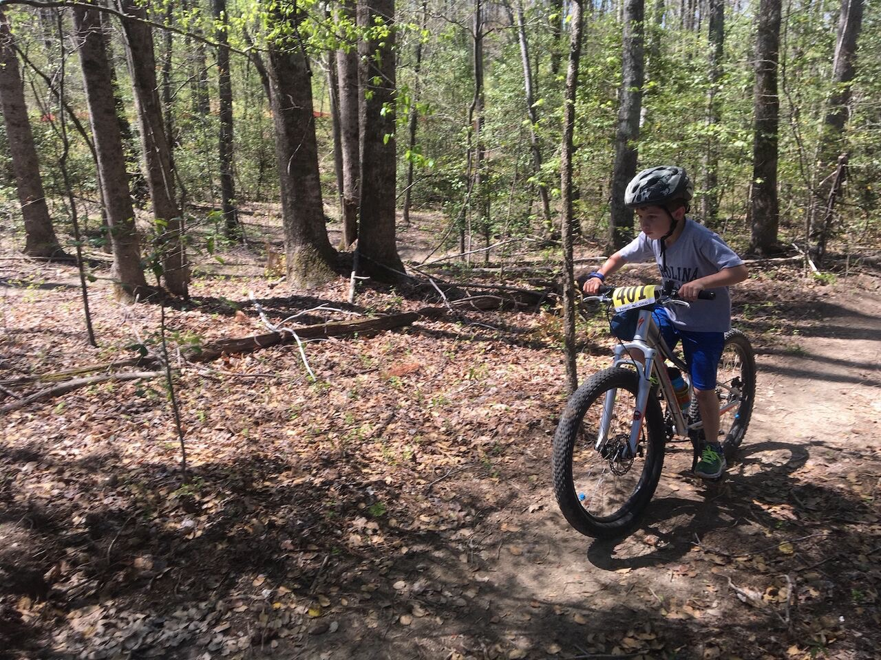
Events
TORC holds local group rides nearly year-round throughout the various trails for all different skill levels, with beginner rides being some of the most popular
At Briar Chapel we hold night time rides to increase participation
For the grand opening of Wendell Falls we held our first race within the community.

Slide 39
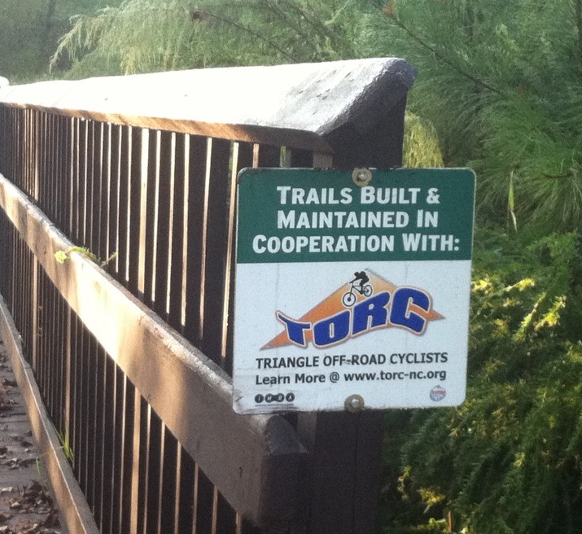
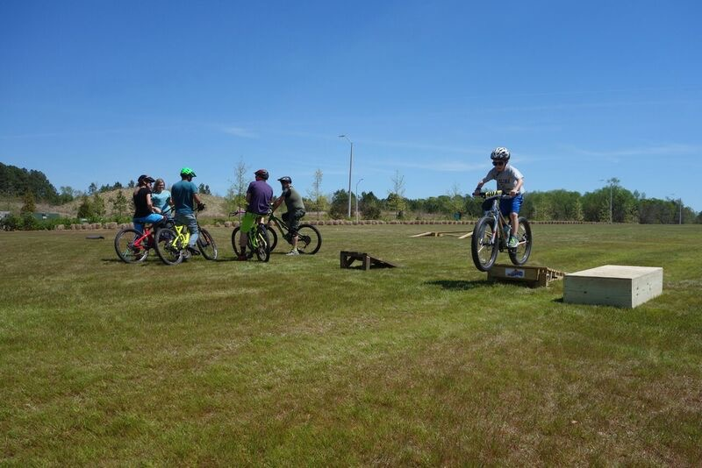
Maintaining Trails
TORC schedules workdays for the 500+ volunteers throughout the year to assist in the singletrack construction or maintenance of existing trails
For Briar Chapel we act as custodians of the trails insuring that the trails are safe and clean for all to enjoy
Maintaining trails is essential to ensure that new trails get built, existing trails remain stable, and that we maintain strong relationships with local public and private land owners

Slide 40
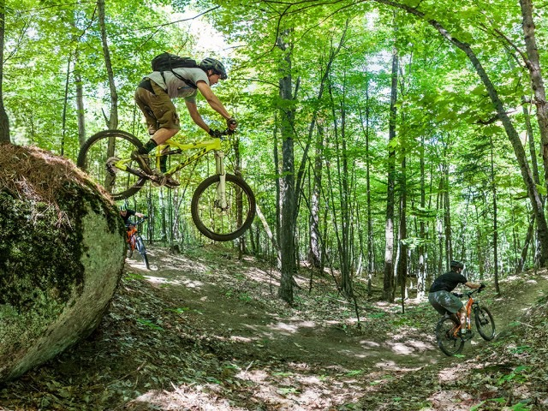
Wendell Falls and Briar Chapel
Private land owner sought assistance to build and develop trails as well as build and develop community
The success of these trails have provided acceptance of the communities within the larger, regional community as well as adding to the overall length of trails for all to use
By having the unique and challenging trails, the bike community has grown significantly since the first trail was constructed in Briar Chapel

Slide 41
