Slide 1
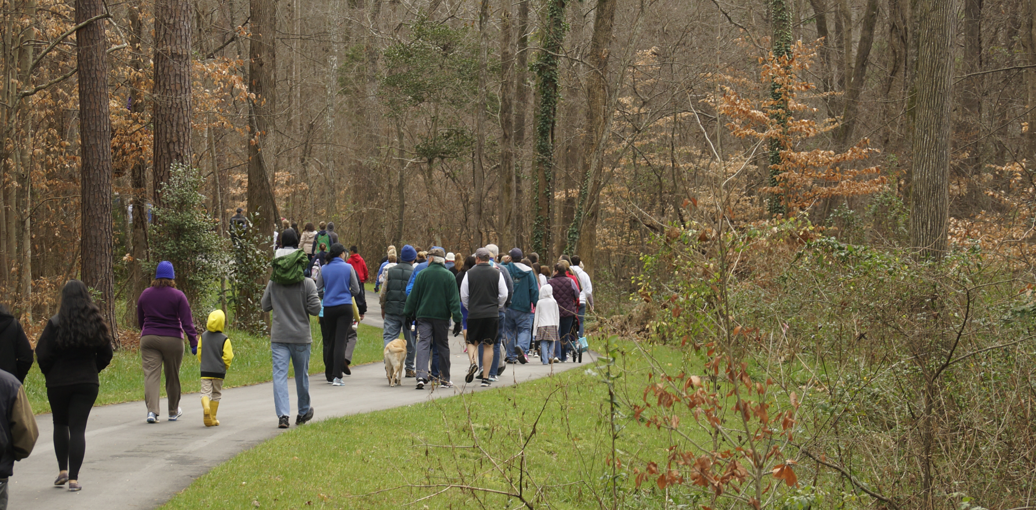
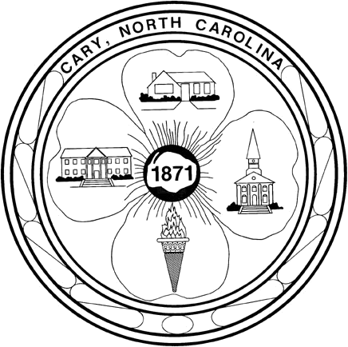
Fast Tracking Greenway Construction: Town of Cary as Case Study
2017 Southeast Greenways & Trails Summit
Sandi Bailey, Facilities Planning, Town of Cary

Slide 2
Outline
Introduction & Background
Cary’s Developer-Built Greenways Program
Project Example
Benefits and Challenges
Fast Tracking Greenways in Your Community

Slide 3
Introduction
&
Background

Slide 4
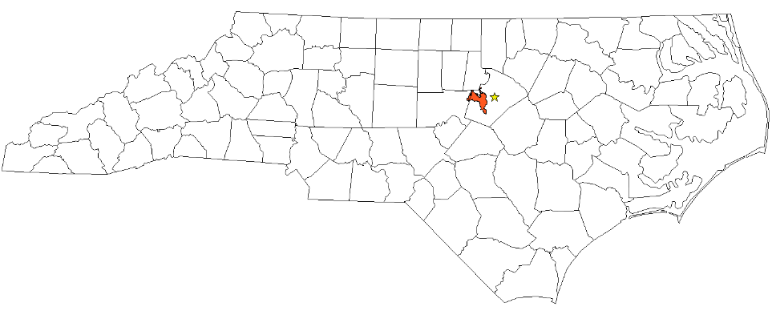
Cary, North Carolina
CARY
Wake & Chatham Counties
57 square miles
Population ~156,000
7th largest NC city (population)

Slide 5
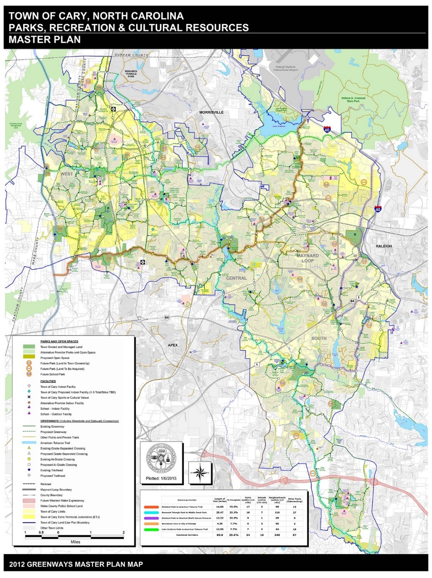
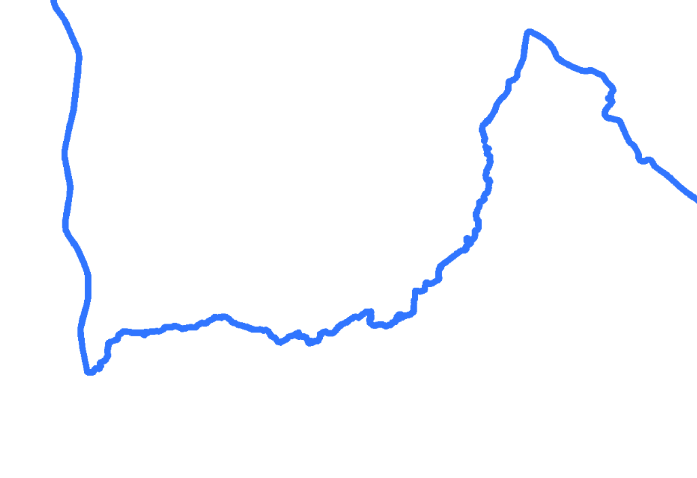
Cary Greenways Overview
· Bordered by significant regional and state recreation facilities
· 79+miles of trail on the ground
· 200+ mile network proposed

Slide 6
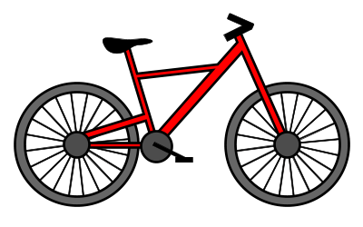
Greenway Miles
Average 10 Largest NC Communities
Town of Cary
Over 79 miles of trail; 2nd highest in state
= 5 miles

Slide 7
Greenway Miles per 1000 Population
Average 10 Largest NC Communities
Town of Cary
½ mile per 1000;
highest in state
= 1/10 mile

Slide 8
How did we get here?
…not by managing all greenway construction as capital projects with 2-3 parks & greenway planners

Slide 9
Greenway Construction & Funding Methods
Developer-Built Greenways (2003/2004)
Capital Project – Grant Funding
Capital Project – Town Funds
Constructed Greenway Network

Slide 10
47% of Cary’s Existing Greenways were constructed by and with private development… 37.8 Miles of Developer-Built Greenways

Slide 11
The Town of Cary
Developer-Built Greenways Program

Slide 12
Implementation
NCGS 160A-132 “A subdivision control ordinance may provide for the orderly growth and development of the city; … for the dedication or reservation of recreation areas… or, alternatively, for provision of funds to be used to acquire recreation areas…”
Payments in Lieu of Park Land Dedication
Payment in lieu credit for greenway construction
Park Land Dedication
Greenway Easements

Slide 13
Process
Development Proposal
Reference PRCR Master Plan
Identify greenway construction
Construction
Create Invoice to reflect credits
Design Review
Municipal Inspections
Project Acceptance
Greenway Open to Public

Slide 14
Project Example

Slide 15
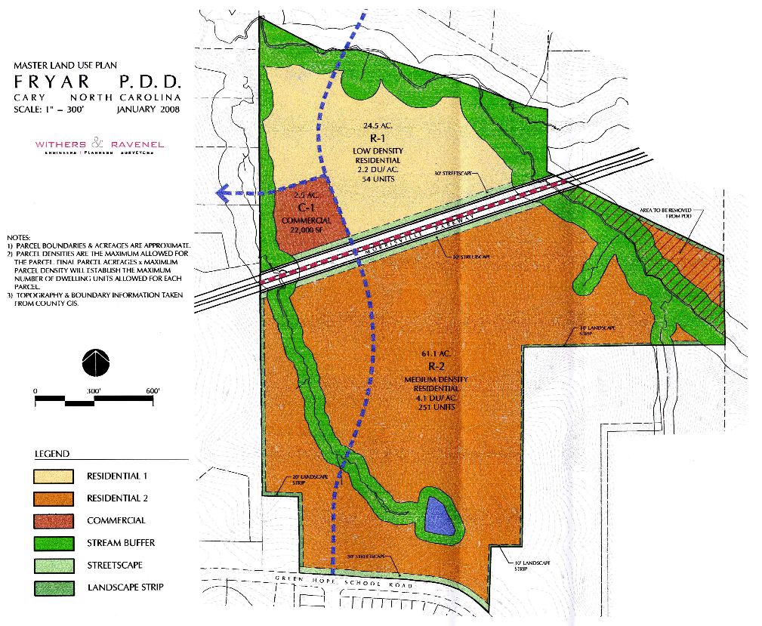
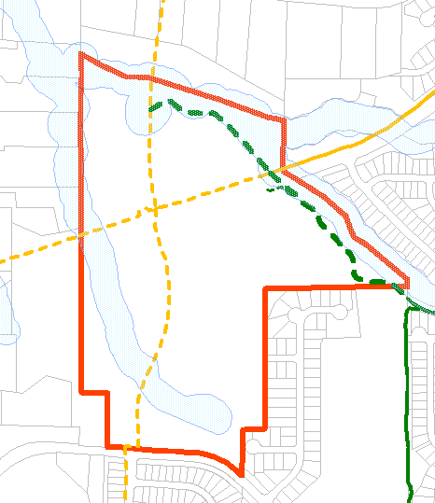
Fryars Gate
Proposed Development
PRCR Master Plan

Slide 16
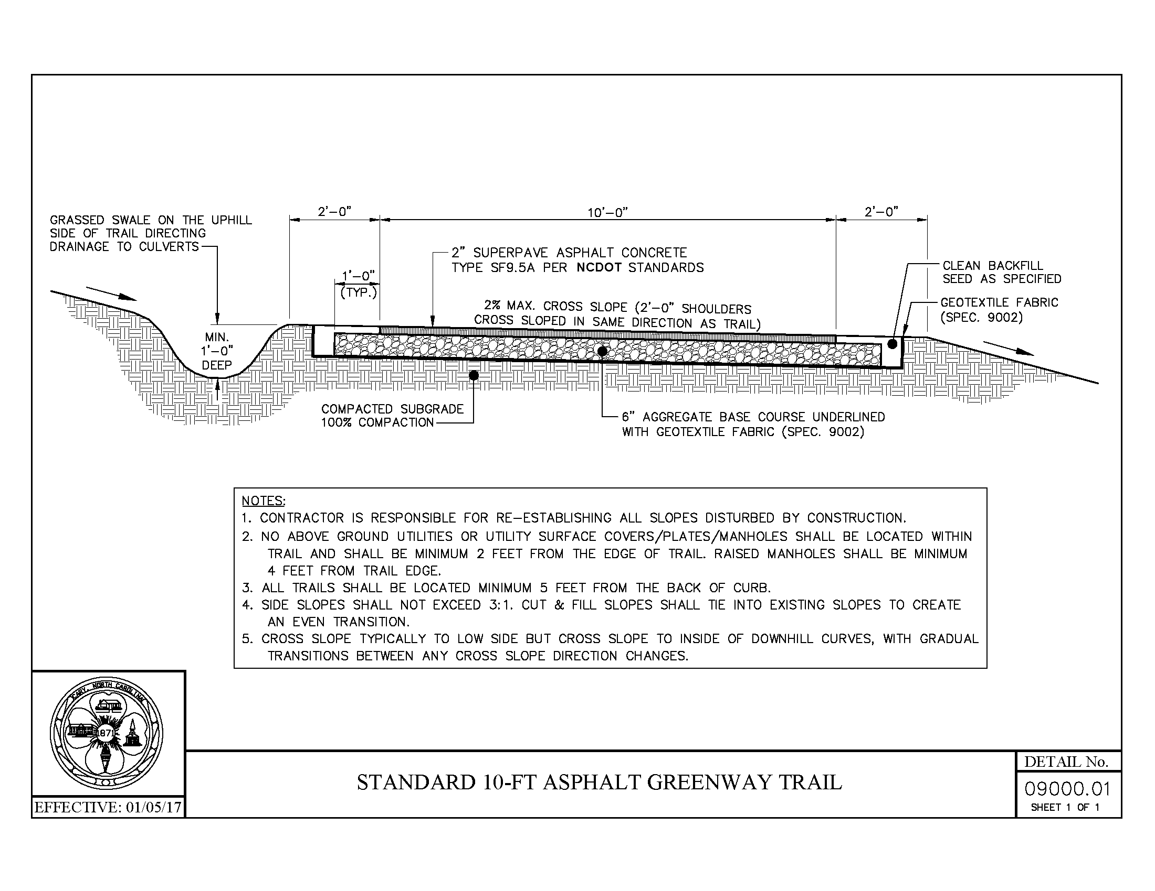
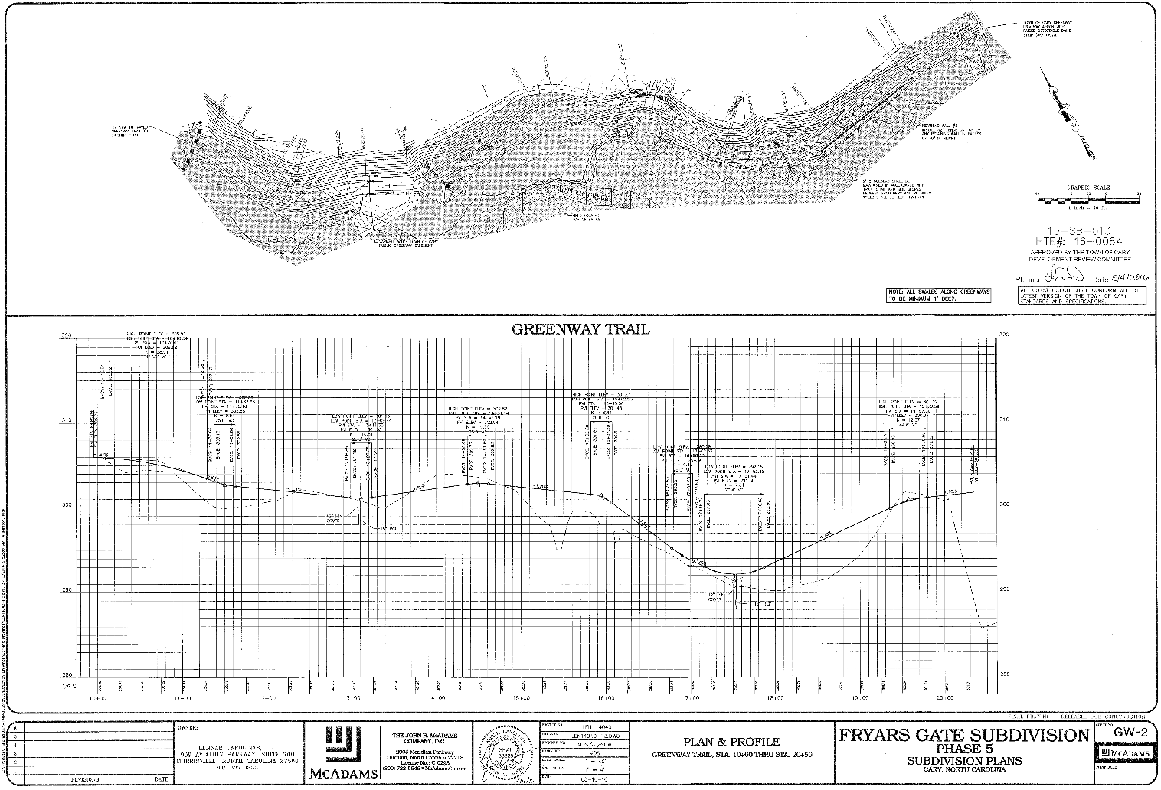
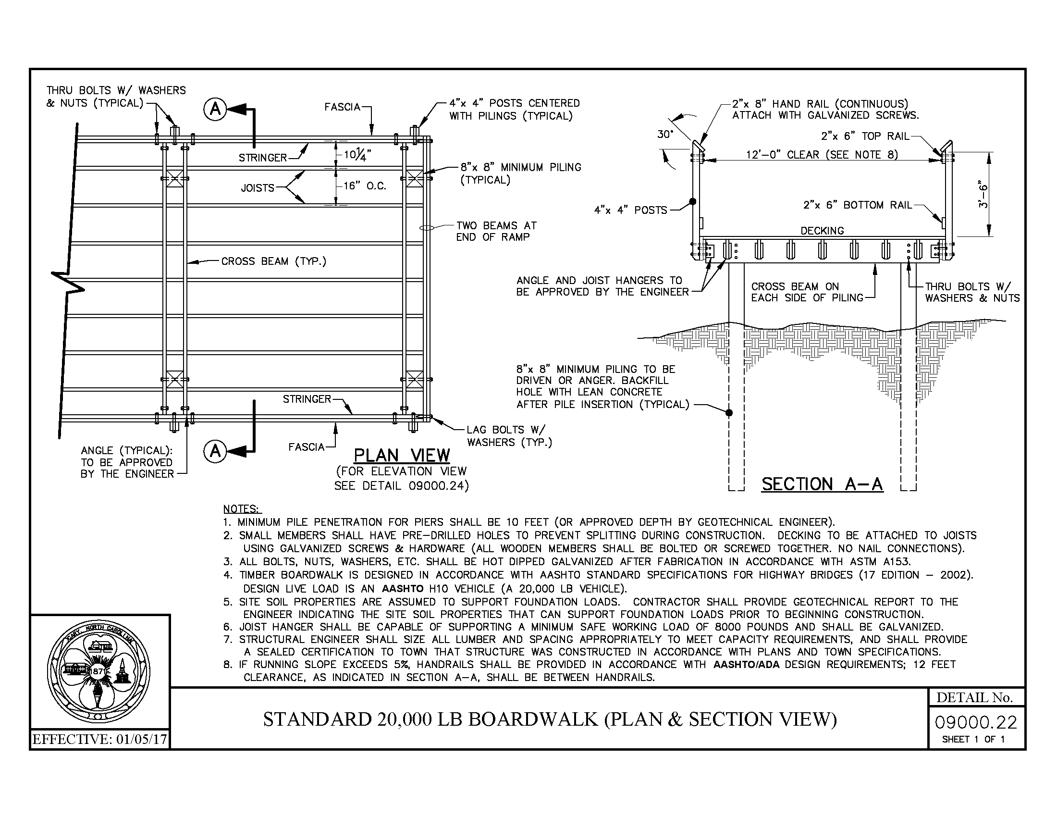
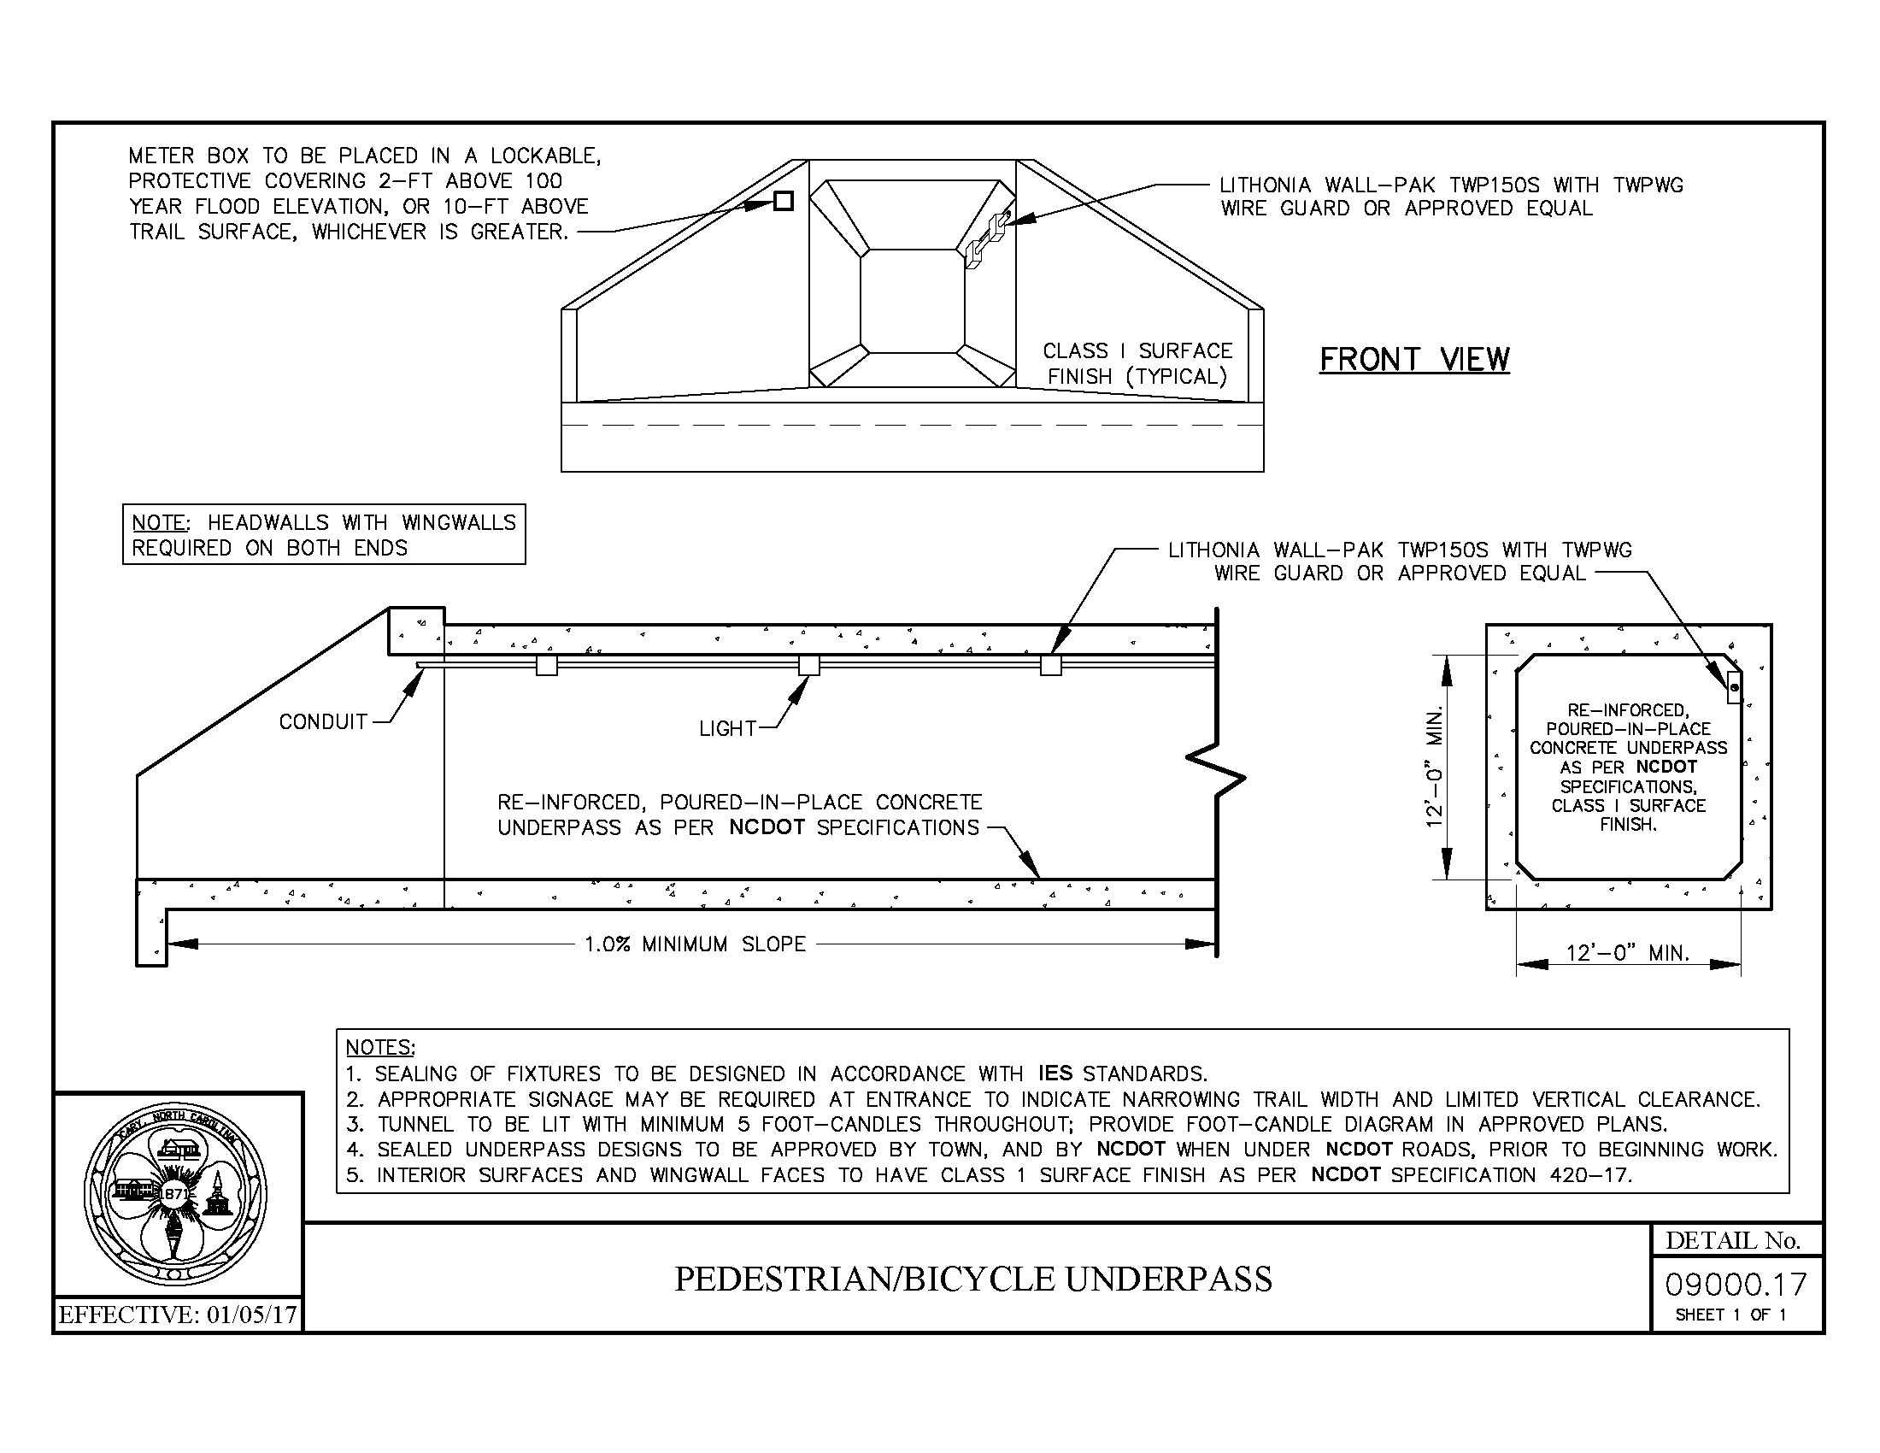
Design Review

Slide 17
Construction Credit & Payment Reconciliation
Owe $800,714
295 Units
295/35 = 8.4ac
8.4x$95K/ac
Minus $734,065 in Credits
$669,465 in Construction
$64,600 in Easement
Invoice for $66,649
$800,714 - $734,065 = $66,649 Balance Due

Slide 18
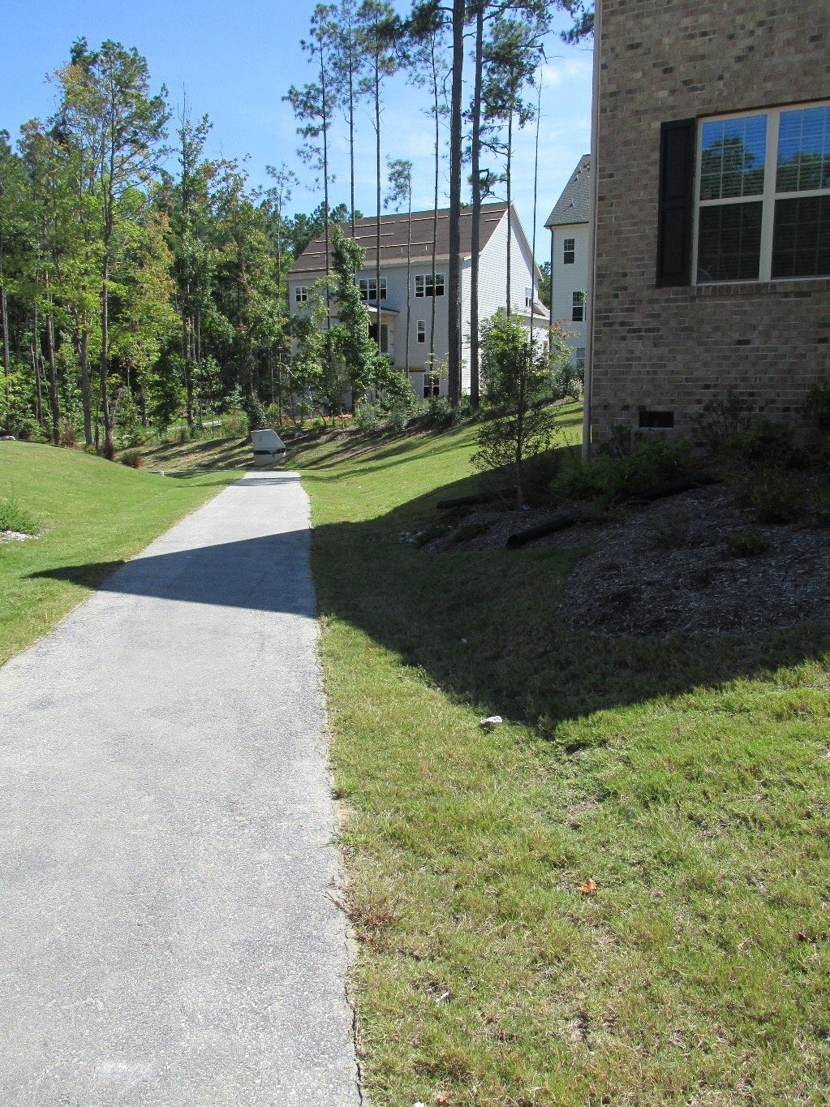
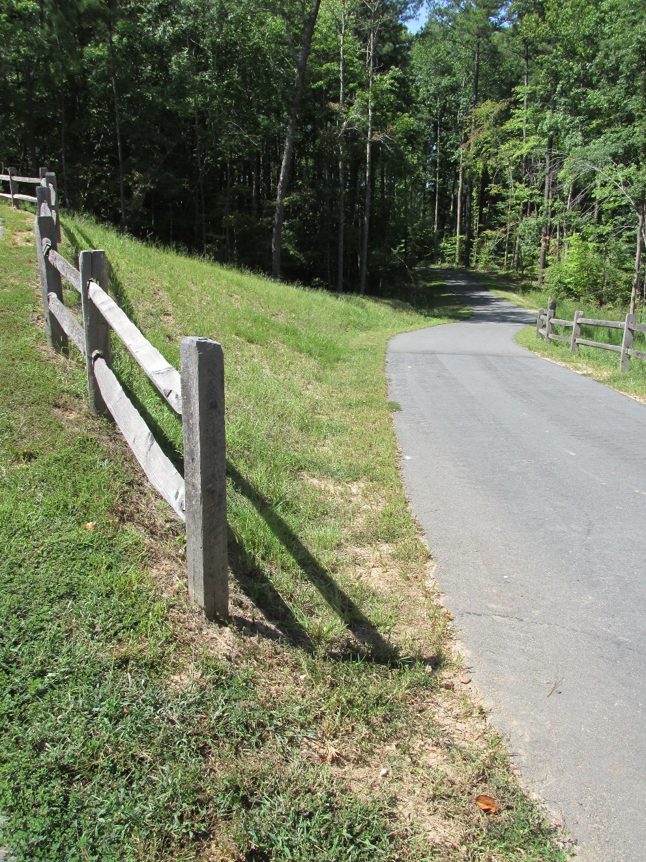
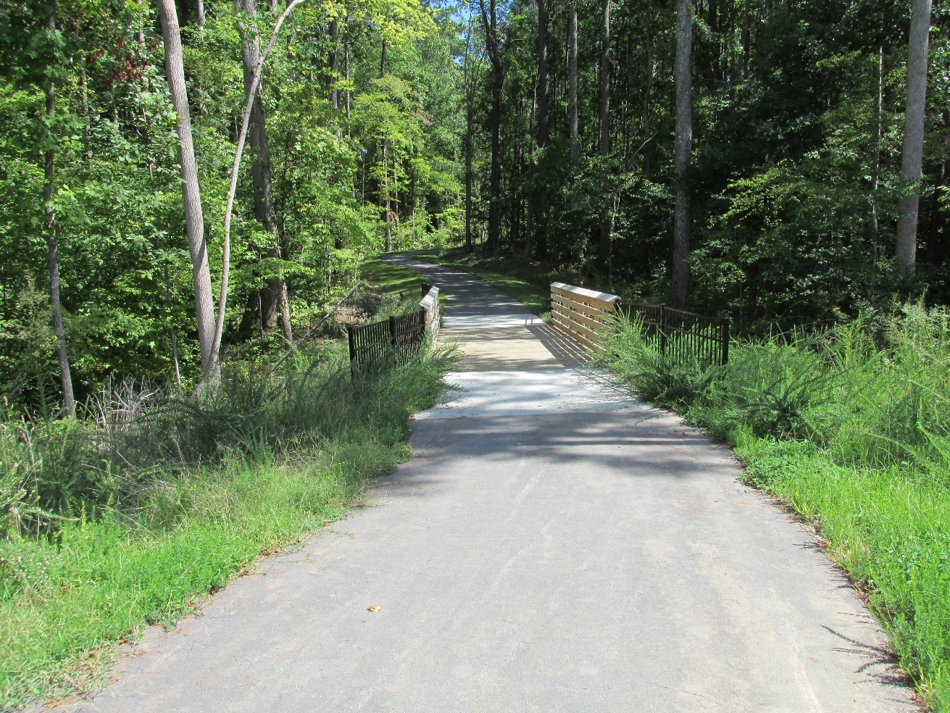
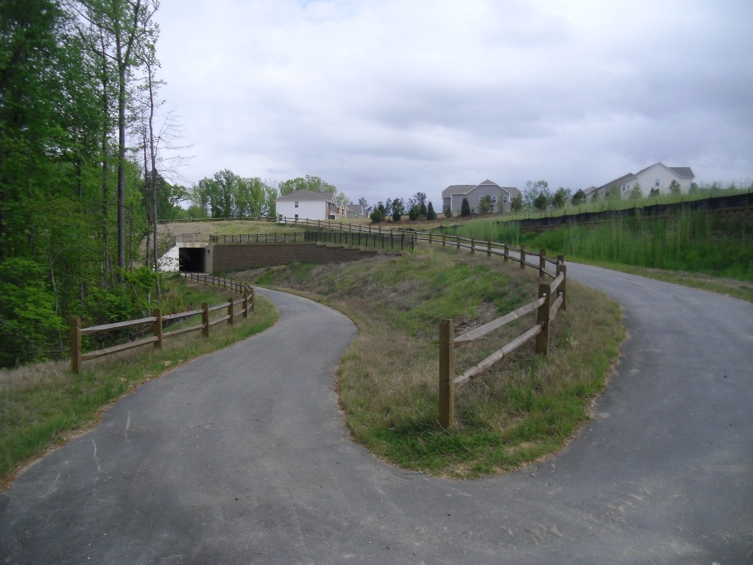
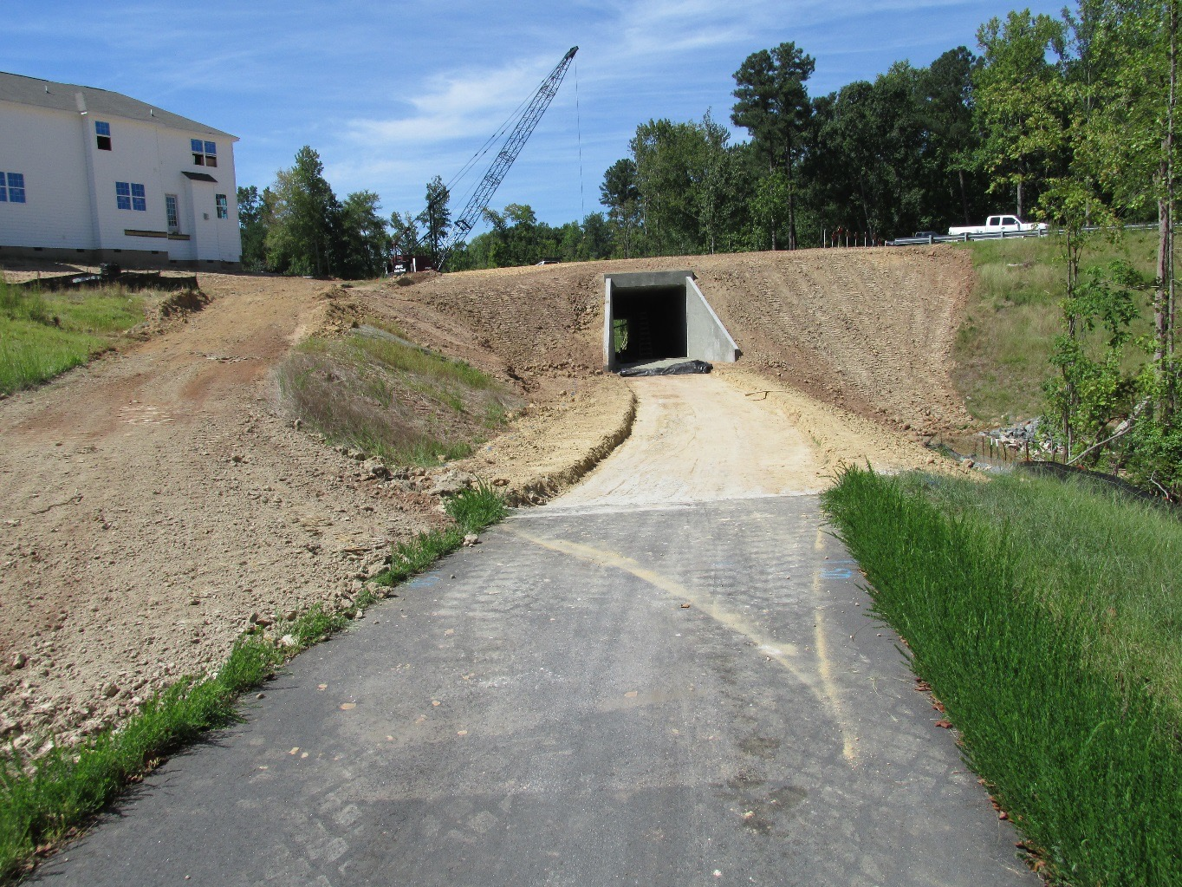
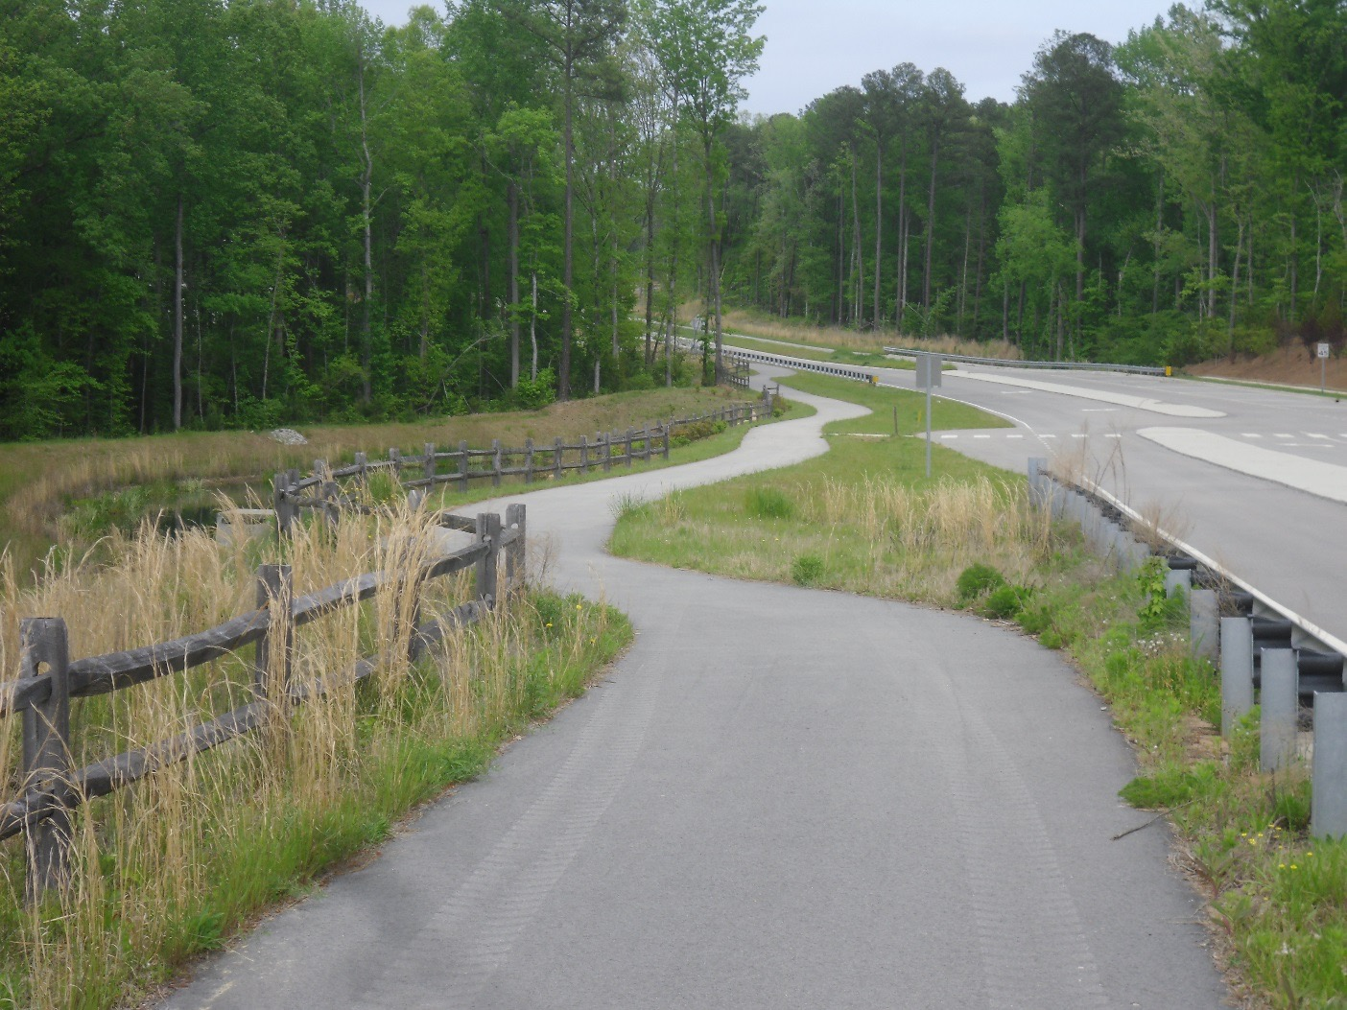
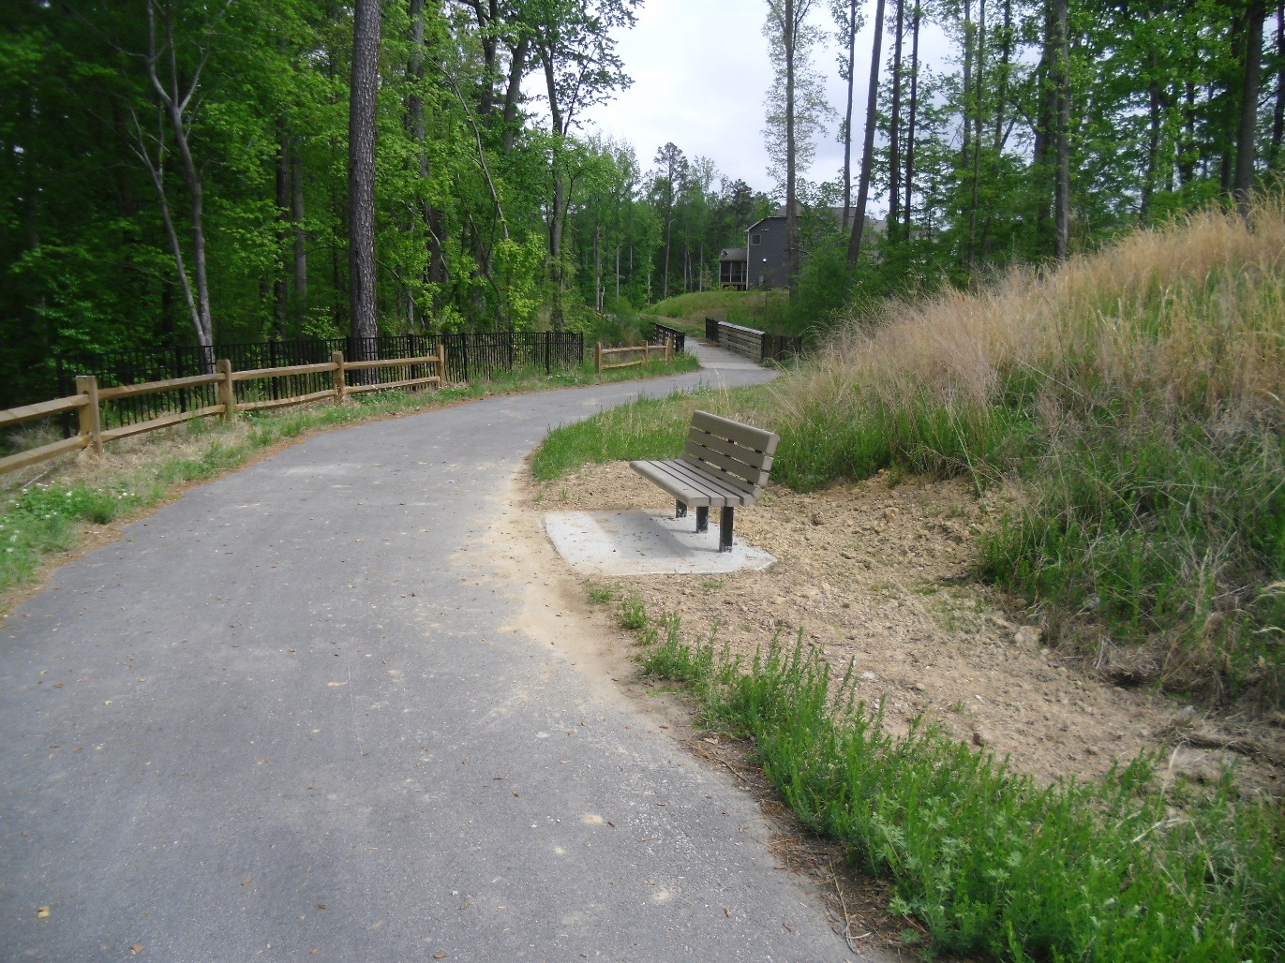
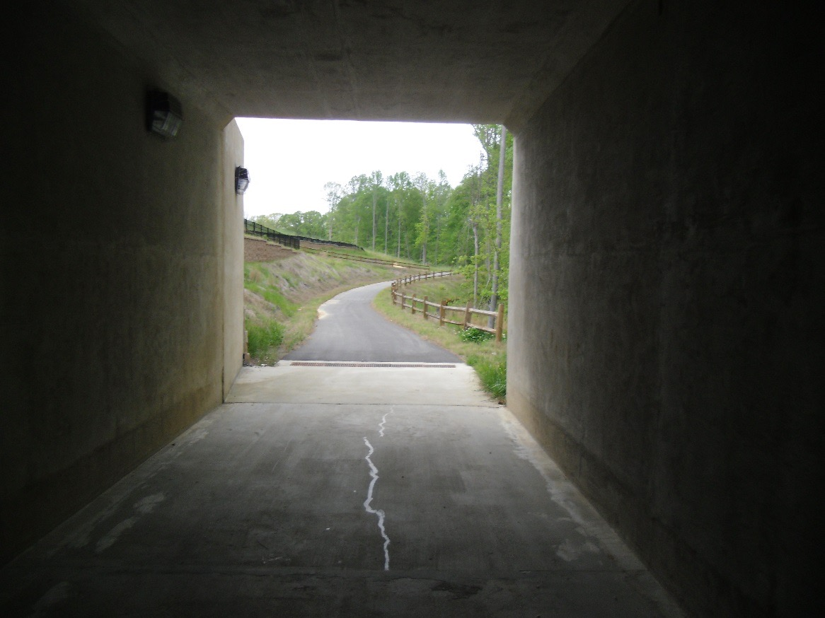
Fryars Gate Greenways
1/2 Mile of 10’ wide off-road greenway
.8 Miles of meandering 10’ wide street-side trail
198’ Pedestrian Tunnel under a 4-lane, median-divided thoroughfare
3 Neighborhood connector trails
Notes:
Things to say about steps:
Identify
Work with developer
Must meet town standards
field inspections
GOAL: don’t just turn it over for the developer to build – it must meet town standards just like any other infrastructure
KEY TO SUCCESS – also neighborhood connector

Slide 19
Benefits
And
Challenges

Slide 20
Challenges
Developer and contractors may view greenway as unnecessary luxury, not a priority
Sometimes challenging to get developer’s engineers and contractors to meet Town standards
Managing design & construction oversight with limited staff
Unconnected trail segments (this can be good and bad)

Slide 21
Benefits
Faster system growth with less staff
Immediate amenity for residents
Construction easier prior to residents moving in
Facilities grow with population
Ensuring buildout of network
Flexibility in design

Slide 22
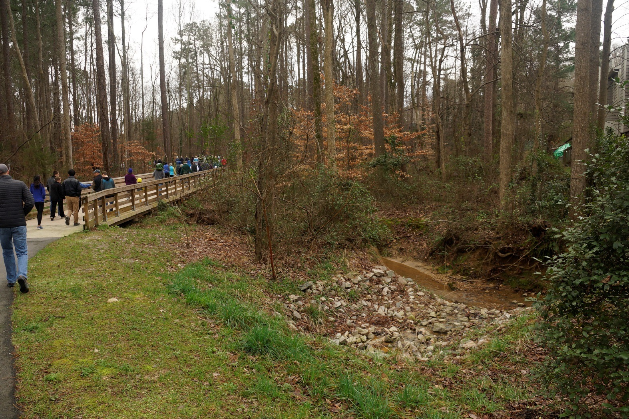
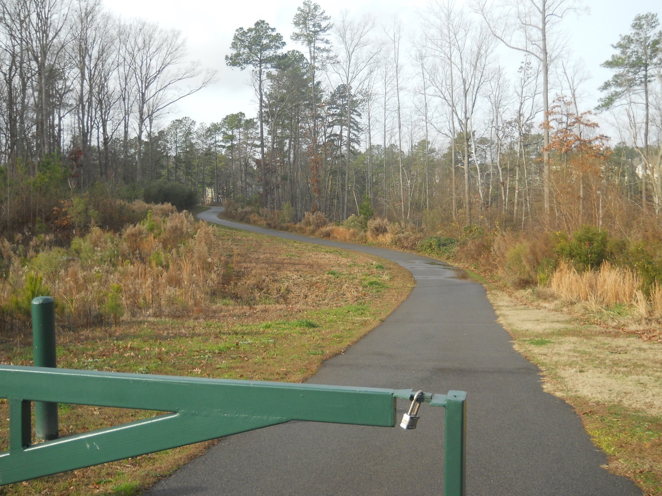
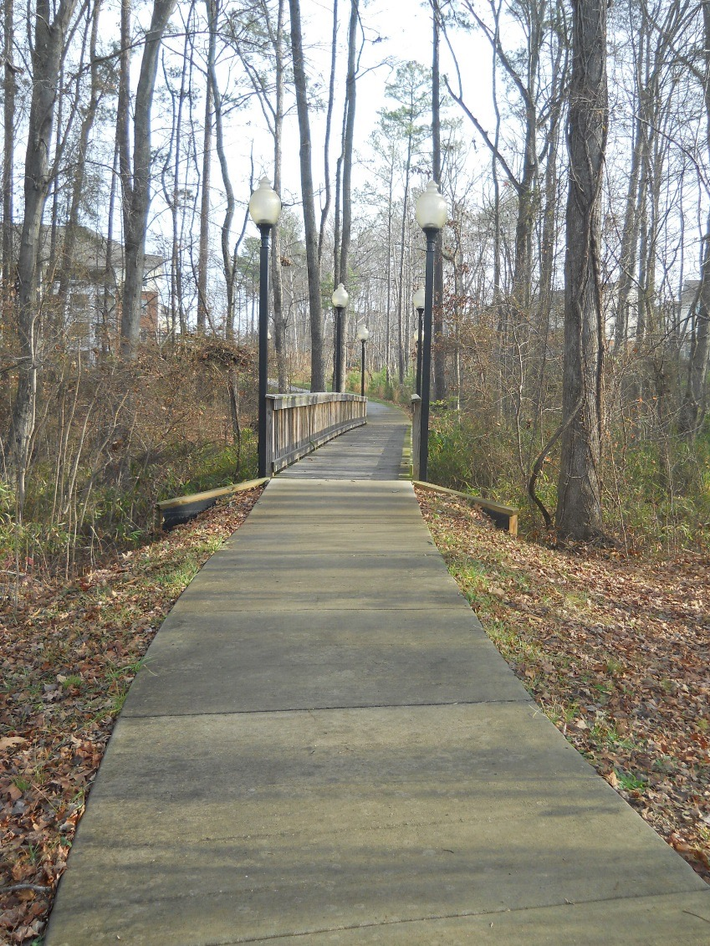
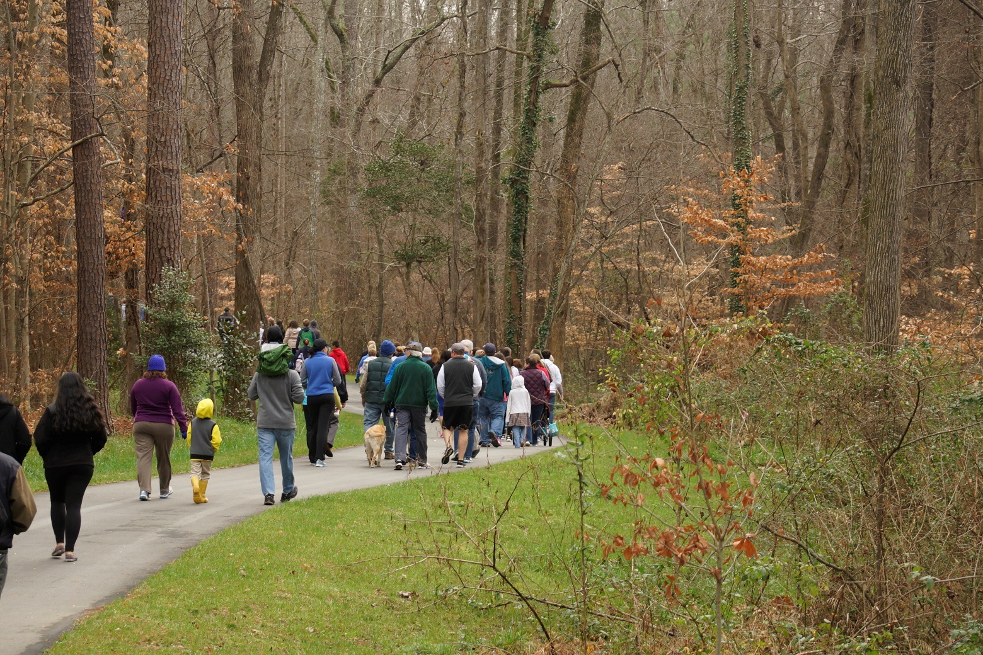
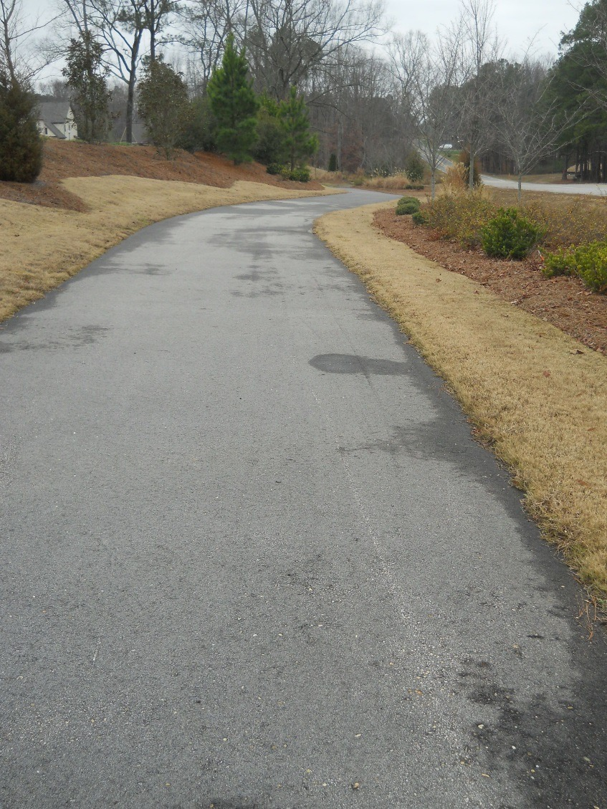
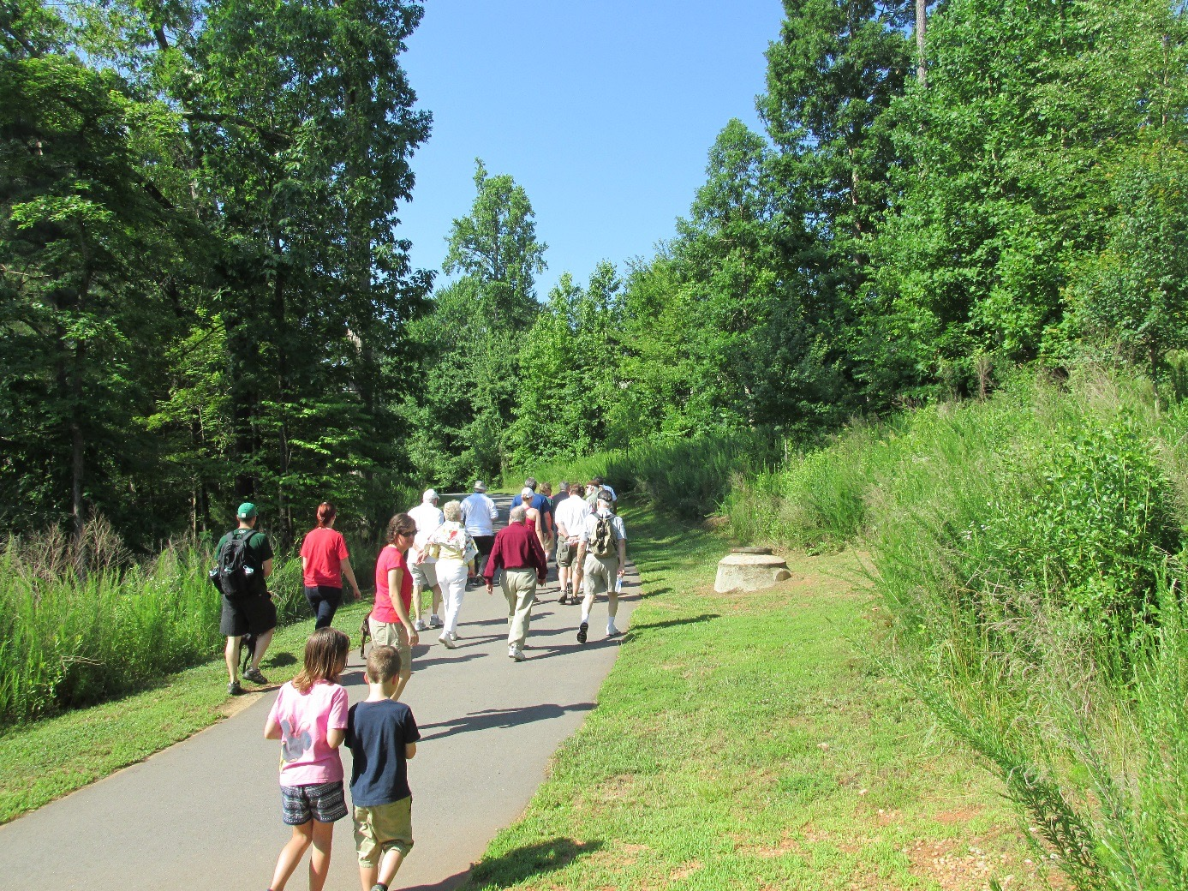
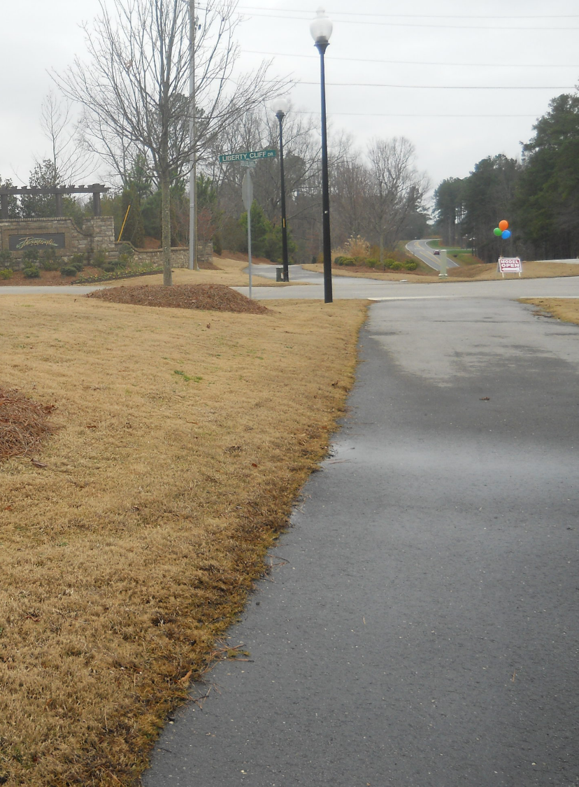
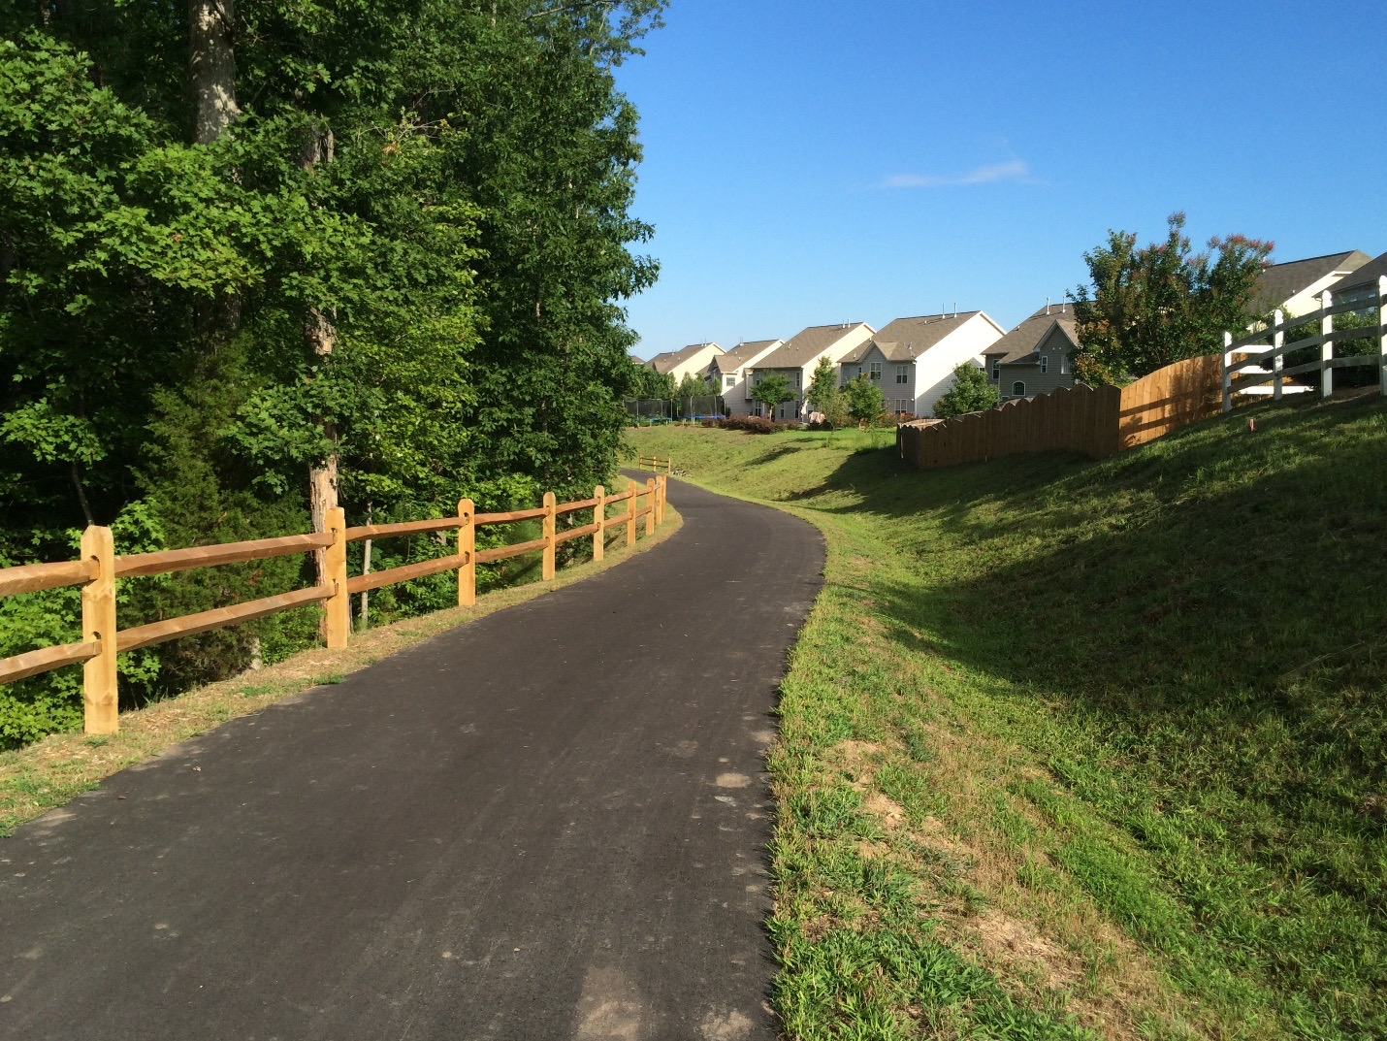
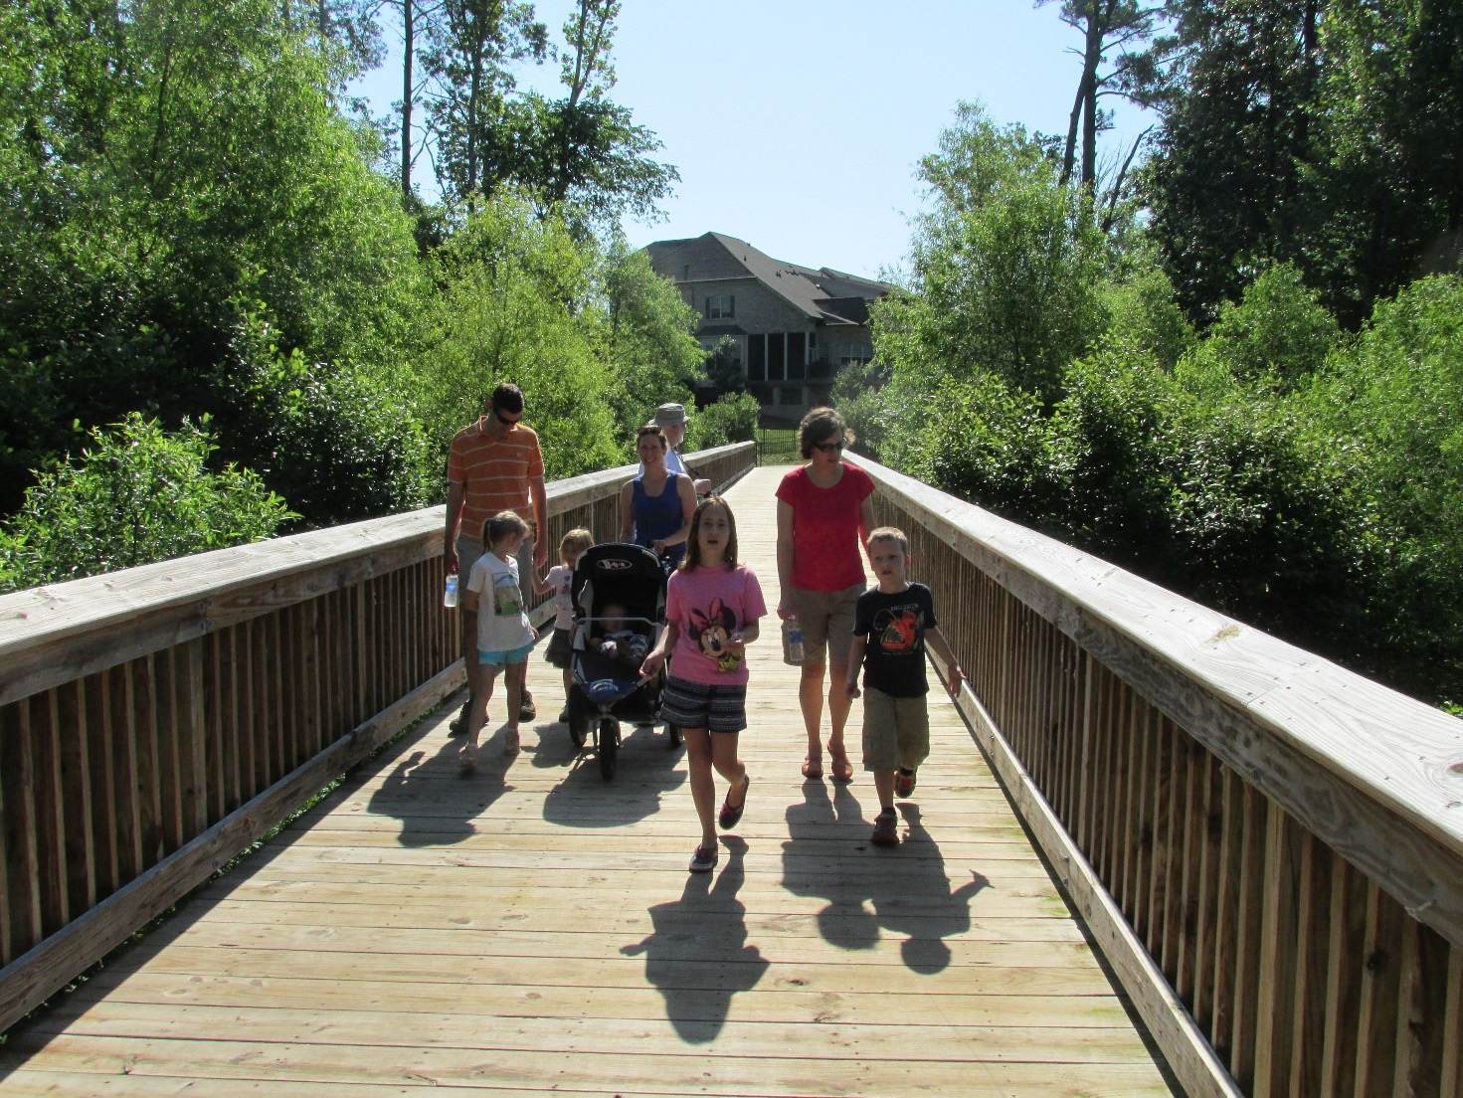
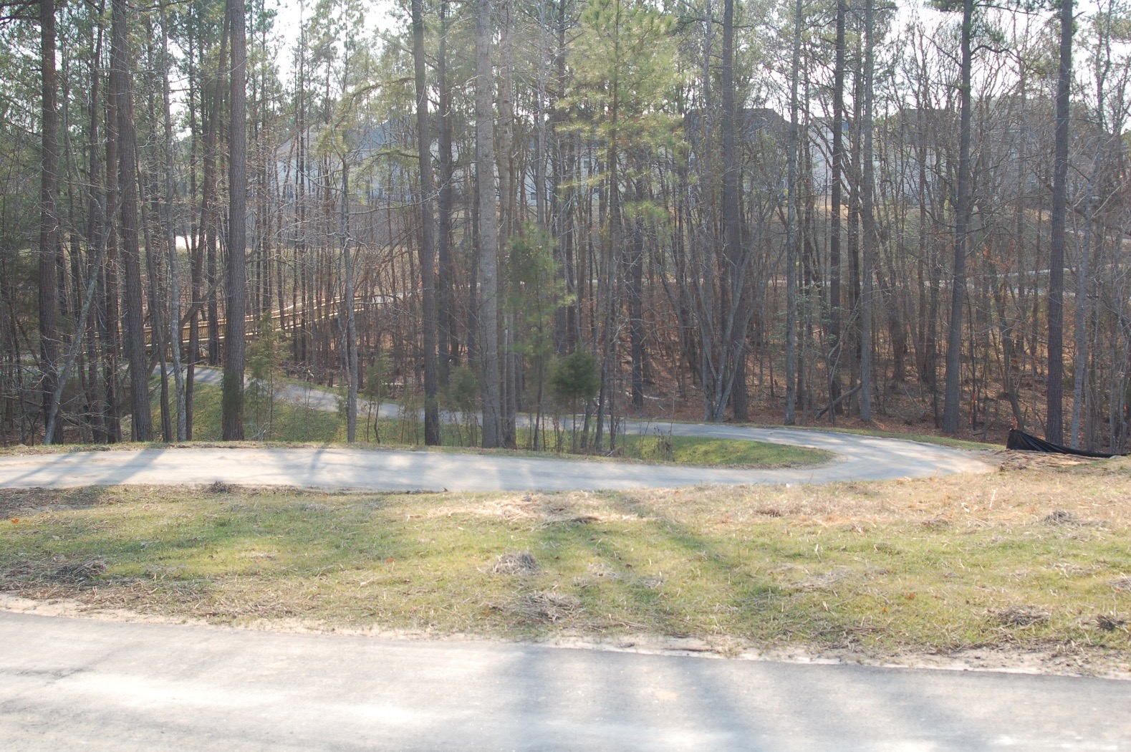
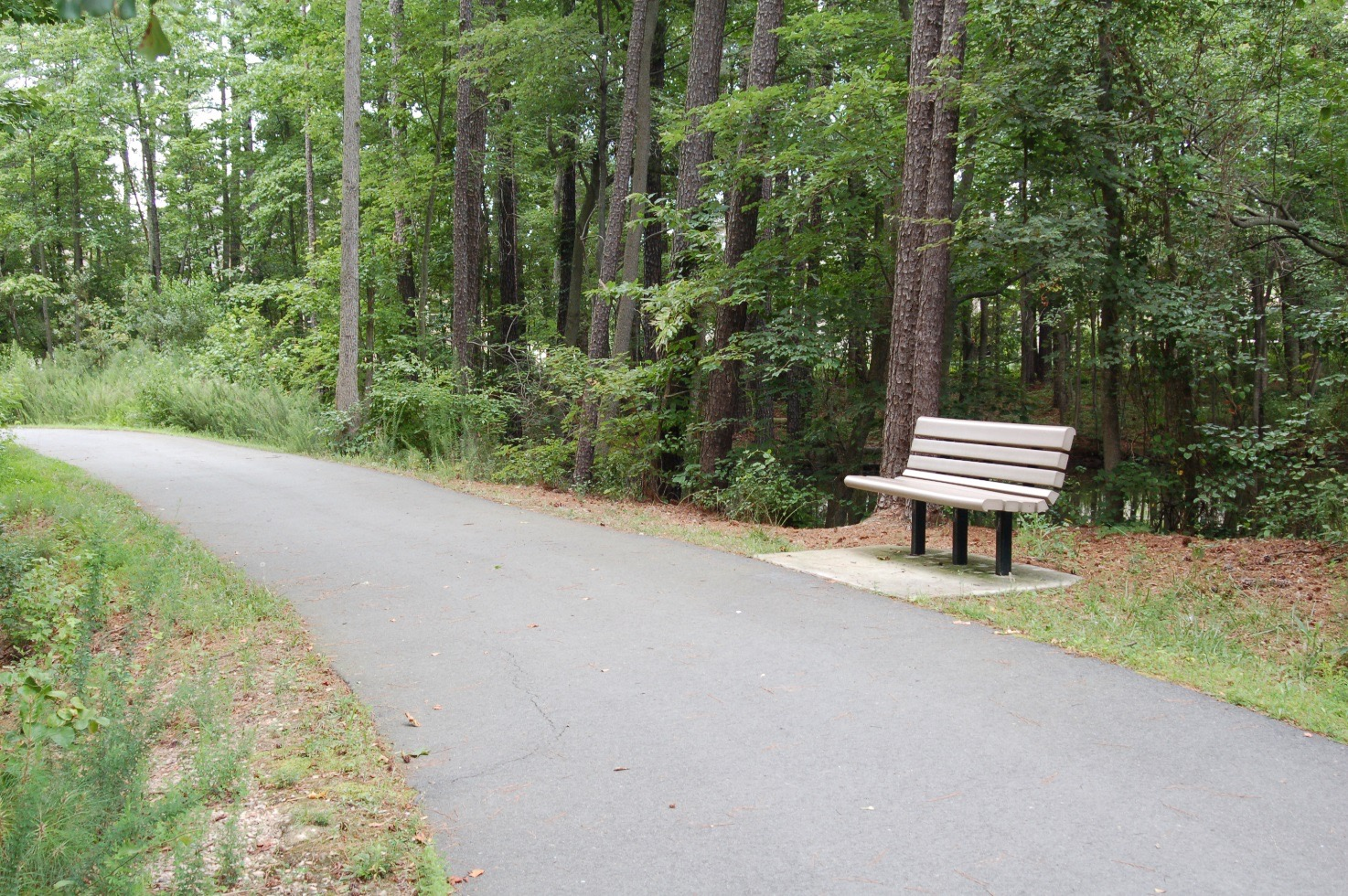
Other Developer-Built Greenways

Slide 23
Fast Tracking Greenways in Your Community

Slide 24
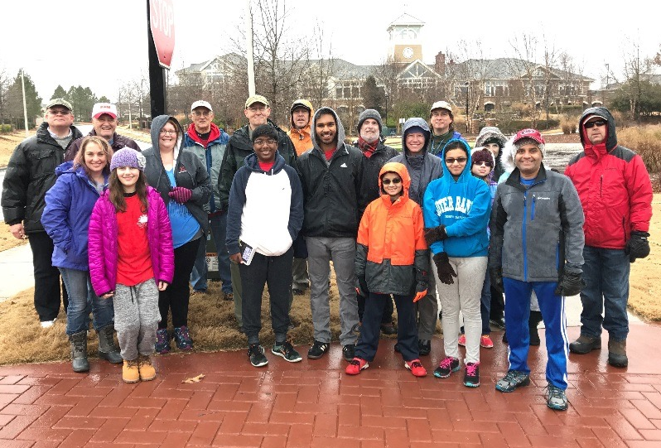
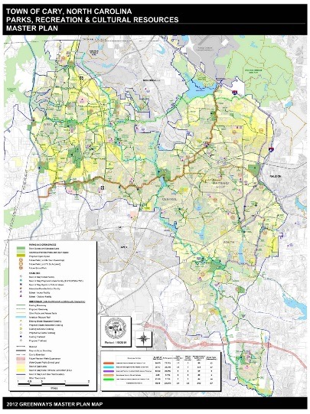
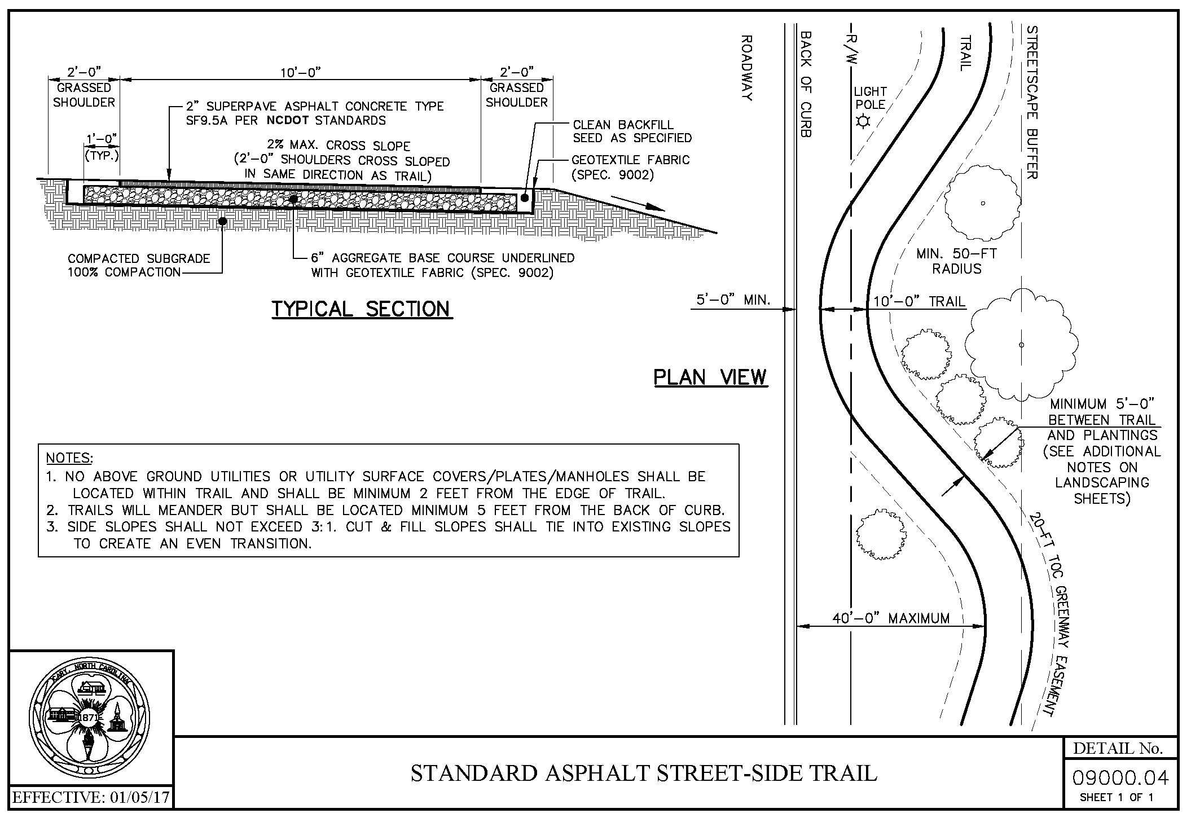
Steps to Consider
Develop support
Develop or update Greenways Master Plan
Address/amend Ordinance Language
Construction Standard Specifications & Details
Standard Operating Procedures

Slide 25
Questions?

